Slide 1
An Introduction to Computational Neuroscience: from Brain simulation to NeuroAI Project 2
Yueying Luo, Yuanpei College
Aiyu Wang, School of Physics
Jiarui Sun, School of Life Science

Slide 2
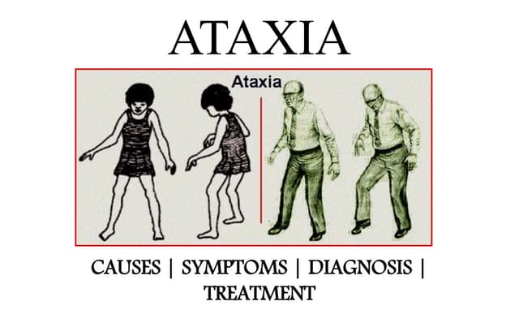
Outline
Introduction
Ion Channelopathies
Cerebellar Ataxia
Purkinje Cell
Method
Model
Channel Knockout
Result
Discussion
From Google

Slide 3
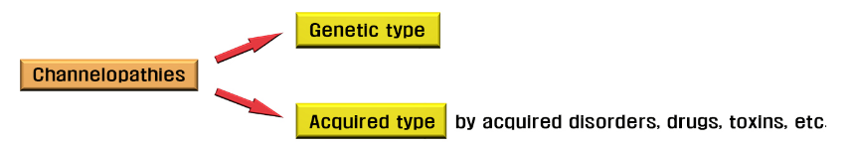
Ion channelopathies
A heterogeneous group of disorders resulting from the dysfunction of ion channels
Diseases
Cardiovascular system, Respiratory system, Endocrine system, Immune system
Nervous system: Epilepsy, ataxia
June-Bum Kim, Korean Journal of Pediatrics, 2014
Notes:
Channelopathies are a heterogeneous group of disorders resulting from the dysfunction of ion channels located in the membranes of all cells and many cellular organelles. These include diseases of the ner vous system (e.g., generalized epilepsy with febrile seizures plus, familial hemiplegic migraine, episodic ataxia, and hyperkalemic and hypokalemic periodic paralysis), the cardiovascular system (e.g., long QT syndrome, short QT syndrome, Brugada syndrome, and catecholaminergic polymorphic ventricular tachycardia), the respiratory system (e.g., cystic fibrosis), the endocrine system (e.g., neonatal diabetes mellitus, familial hyperinsulinemic hypoglycemia, thyrotoxic hypokalemic periodic paralysis, and familial hyperaldosteronism), the urinary system (e.g., Bartter syndrome, nephrogenic diabetes insipidus, autosomal dominant polycystic kidney disease, and hypomagnesemia with secondary hypocalcemia), and the immune system (e.g., myasthenia gravis, neuromyelitis optica, Isaac syndrome, and anti NMDA [N methyl D aspartate] receptor encephalitis
（例如，全身性癫痫伴热性惊厥加、家族性偏瘫性偏头痛、发作性共济失调、高钾血症性和低钾血症性周期性麻痹）、心血管系统（例如长 QT 综合征、短 QT 综合征、Brugada 综合征和儿茶酚胺敏感性多形性室性心动过速）、呼吸系统（例如囊性纤维化）、内分泌系统（例如新生儿糖尿病、家族性高胰岛素血症性低血糖、甲状腺毒性低钾血症性周期性麻痹）和家族性醛固酮增多症）、泌尿系统（例如 Bartter 综合征、肾性尿崩症、常染色体显性遗传性多囊肾病和低镁血症伴继发性低钙血症）和免疫系统（例如重症肌无力、视神经脊髓炎、Isaac 综合征和抗 NMDA [N 甲基 D 天冬氨酸] 受体脑炎）。

Slide 4
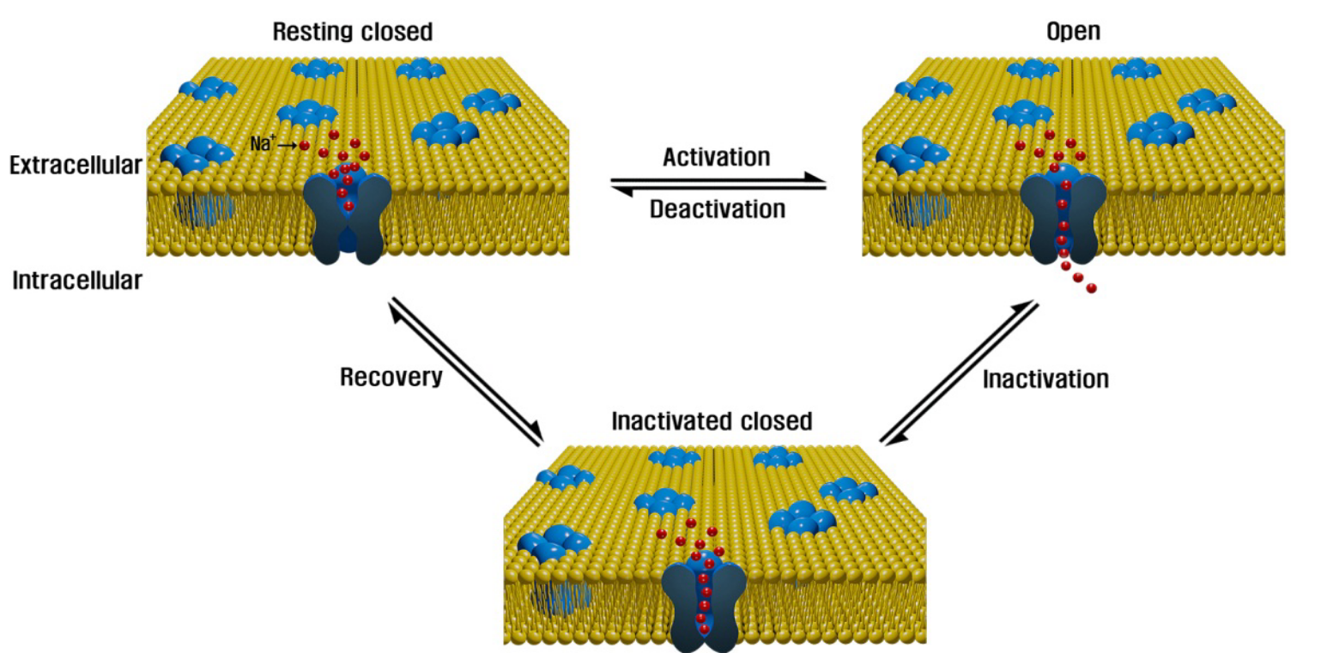
Ion channelopathies
Gating controlling factors: membrane potential, ligands, second messengers, light, temperature, and mechanical changes.
June-Bum Kim, Korean Journal of Pediatrics, 2014
Notes:
Ion channels are transmembrane proteins that allow the passive flow of ions, both in and out of cells or cellular organelles, following their electrochemical gradients. Because the flux of ions across a membrane results in electrical currents, ion channels play a key role in generating membrane potential and function in diverse cellular activities, such as signal transduction, neurotransmitter release, muscle contraction, hormone secretion, volume regulation, growth, motility, and apoptosis. Ion channels can be classified according to the types of ions passing through them, the factors of their gating, their tissue expression patterns, and their structural characteristics. Ion channels typically exist in one of the three states: open, inactivated closed (refractory period), and resting closed (Fig. 2). The gating (opening and closing) of ion channels is controlled by diverse factors, such as membrane potential (voltage), ligands (e.g., hormones and neurotransmitters), second messengers (e.g., calcium and cyclic nucleotides), light, temperature, and mechanical changes. Ion channels are formed from either a single protein (e.g., cystic fibrosis transmembrane conductance regulator, a chloride channel) or, more commonly, from an assembly of several subunits, each a protein encoded by a different gene. More than 400 ion channel genes have been identified4). Further diversity comes from a number of mechanisms, which include the use of multiple promoters, alternative splicing, posttranslational modifications, heteromeric assembly of different principal subunits, and interaction with accessory proteins5).
离子通道是跨膜蛋白，允许离子按照其电化学梯度被动流入和流出细胞或细胞器。由于离子穿过膜的通量会产生电流，因此离子通道在各种细胞活动中产生膜电位和功能方面起着关键作用，例如信号转导、神经递质释放、肌肉收缩、激素分泌、容量调节、生长、运动和细胞凋亡。离子通道可以根据通过它们的离子类型、门控因素、组织表达模式和结构特征进行分类。离子通道通常以三种状态之一存在：开放、失活关闭（不应期）和静止关闭（图 2）。离子通道的门控（打开和关闭）受多种因素控制，例如膜电位（电压）、配体（例如激素和神经递质）、第二信使（例如钙和环核苷酸）、光、温度和机械变化。离子通道由单个蛋白质（例如，囊性纤维化跨膜电导调节因子、氯离子通道）形成，或者更常见的是由多个亚基组装而成，每个亚基是由不同基因编码的蛋白质。已鉴定出 400 多个离子通道基因4）。进一步的多样性来自多种机制，包括使用多个启动子、选择性剪接、翻译后修饰、不同主亚基的异聚组装以及与辅助蛋白的相互作用5）。

Slide 5
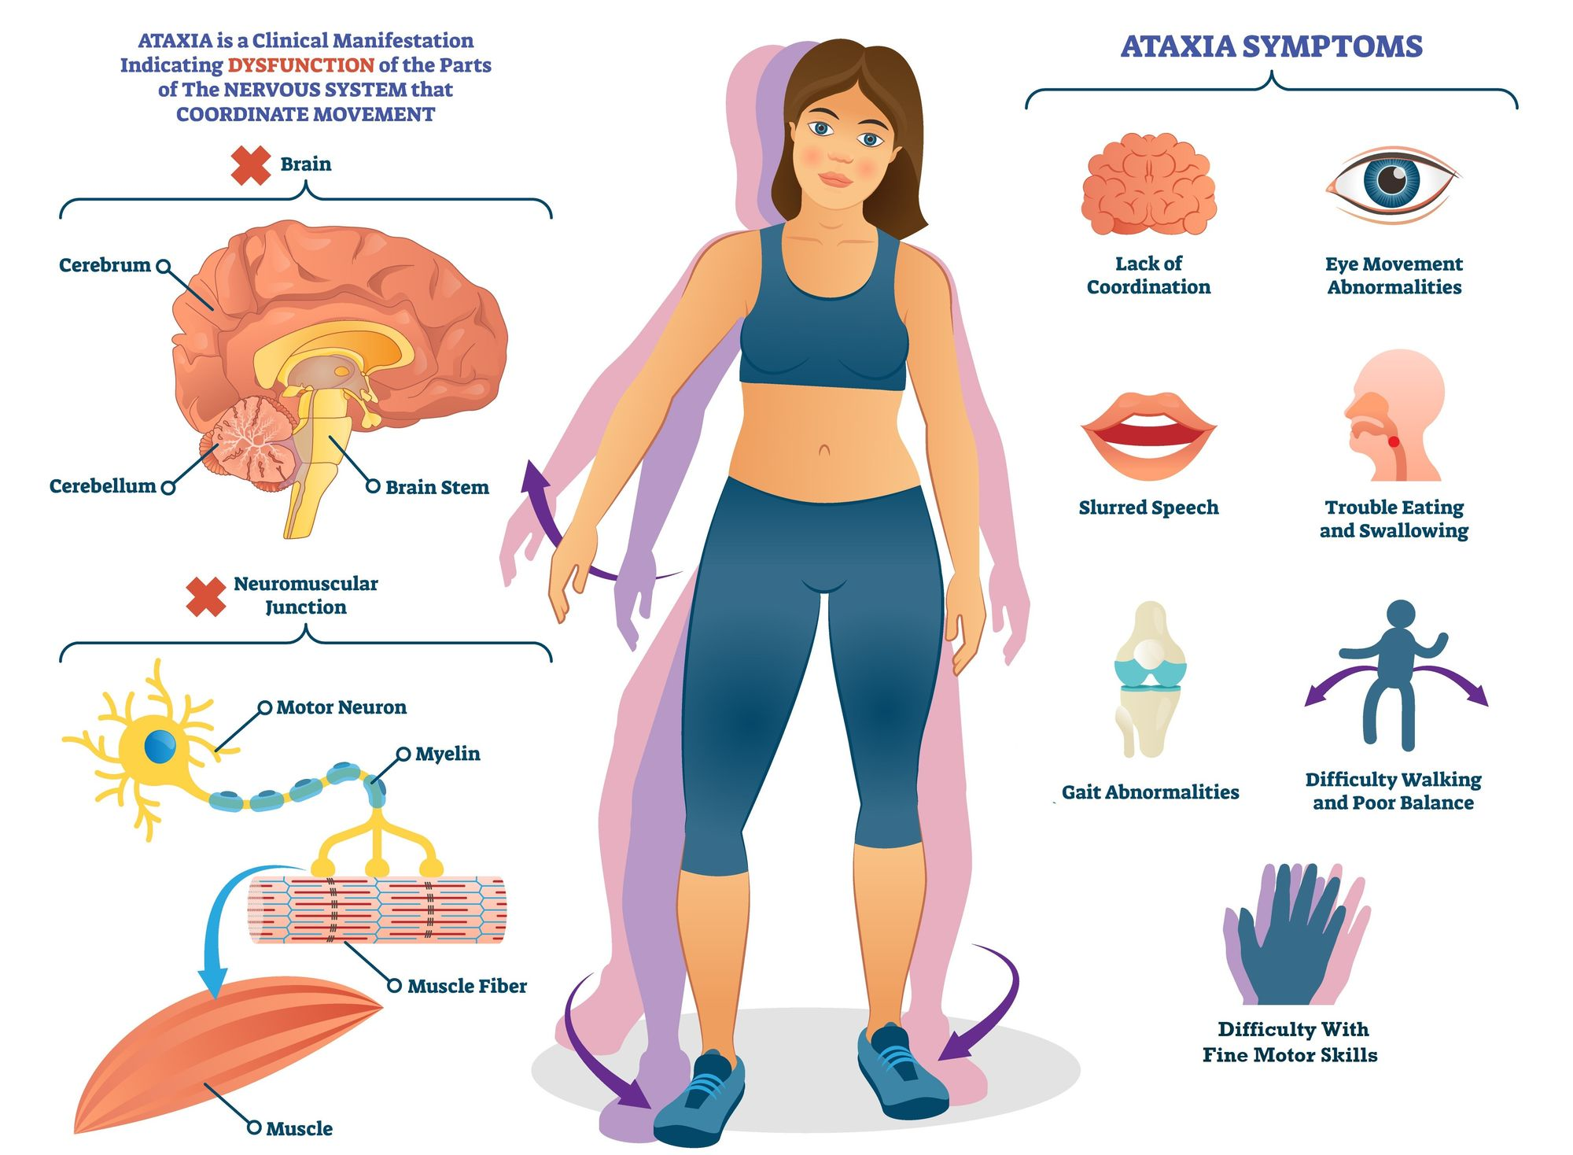
Cerebellar ataxia
A large, heterogeneous group of movement disorders
Diverse disease-causing mutations in the CNS
Purkinje neurons, brainstem neurons, and neurons of the cerebellar nuclei are particularly vulnerable to degeneration.
From Google
Notes:
Cerebellar ataxias are a large, heterogeneous group of movement disorders affecting neurons in the cerebellum and its associated pathways. Clinically, cerebellar dysfunction manifests as unsteady gait, abnormal eye movements, uncoordinated limb movements, and difficulties in speech. Although many cerebellar ataxias share clinical features, genetic causes are diverse and highlight the potential difficulty to diagnose and appropriately treat these disorders. For instance, there are over 30 known genetic mutations associated with autosomal-dominant spinocerebellar ataxia (SCA) that affect a wide variety of molecular pathways [27]. The recent discovery of several new disease-causing SCA mutations suggests that many undiscovered disease genes still remain [19,32,72,95,96].
Although disease-causing mutations in cerebellar ataxia are diverse, and expression of disease proteins are often widespread or ubiquitous throughout the central nervous system, cerebellar involvement is prominent. A subset of SCAs result from glutamine-encoding CAG repeats (the so-called polyglutamine SCAs: SCA1, 2, 3, 6, 7, 17). Although polyglutamine-expanded protein expression is widespread, and not necessarily restricted to just the nervous system, degeneration is restricted to specific neurons in the cerebellum and its associated pathways [87]. Purkinje neurons, brainstem neurons, and neurons of the cerebellar nuclei are particularly vulnerable to degeneration. Among these, Purkinje neurons are most prominently involved in SCAs [27]. The increased susceptibility of Purkinje neurons to degeneration in SCA suggests that these neurons may possess unique metabolic or physiologic properties that make them more vulnerable to a variety of insults. A unique feature of Purkinje neurons that may enhance their vulnerability is that they are autonomous pacemaker neurons which sustain firing 40 Hz even in the absence of synaptic input [36,81]. Perturbations in ion-channel expression and function have the potential to greatly impact Purkinje neuron firing and drive motor impairment

Slide 6
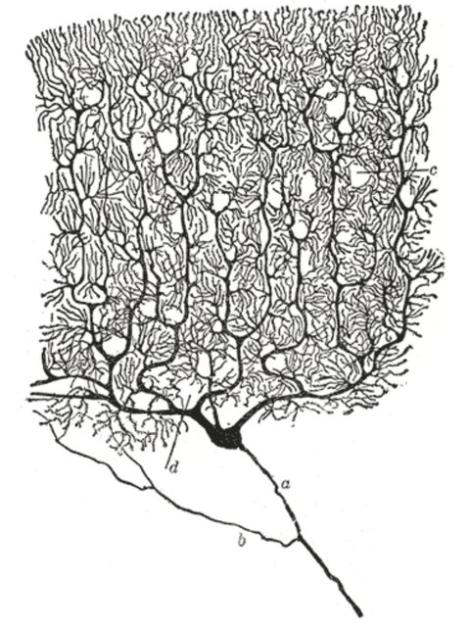
Purkinje cell
Discovered in the 19th century by Jan Evangelista Purkinje
Autonomous pacemaker
Receive and integrate signals from several distinct neuronal pathways
Fast modulation of this firing to encode information
Inhibitory projection to the cerebellar nuclei
By Cajal
Notes:
A unique feature of Purkinje neurons that may enhance their vulnerability is that they are autonomous pacemaker neurons which sustain firing 40 Hz even in the absence of synaptic input [36,81]. Perturbations in ion-channel expression and function have the potential to greatly impact Purkinje neuron firing and drive motor impairment.
Purkinje neurons receive and integrate signals from several distinct neuronal pathways. Purkinje neuron intrinsic firing is modulated by synaptic activity to modify activity of downstream motor pathways. Under normal conditions, Purkinje neurons can sustain firing at a large dynamic range, up to several hundred spikes per second in vivo [100]. In order to properly transmit motor information, Purkinje neurons must be capable of fast modulation of this firing in order to encode information. There is debate as to whether Purkinje neurons use firing
Microscopically, Purkinje cells have a large, flat, highly branched dendritic tree and a single long axon that forms an inhibitory projection to the cerebellar nuclei. The plane of the dendritic tree is perpendicular to the folds in the cerebellar cortex, with parallel fibers passing through the distal dendritic trees of a large number of Purkinje cells forming weak synapses. A single climbing fiber, as noted above, makes a few hundred synapses to the soma and proximal dendrites. Any given climbing fiber is one of about ten axons from an inferior olivary cell, so the same input is distributed among multiple Purkinje cells.[6] In the 3-layered cerebellar cortex, the Purkinje cells’ bodies make up the middle Purkinje cell layer, while their dendritic trees with the parallel fibers and some of the inhibitory cells, such as basket cells, make up the outer molecular layer.

Slide 7
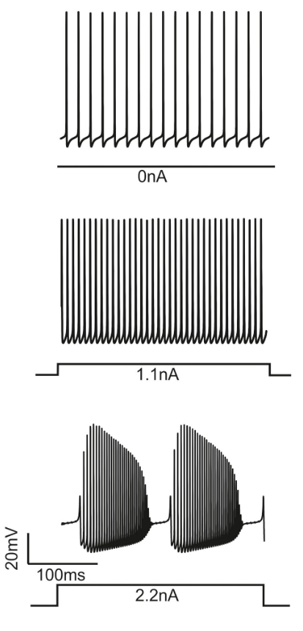
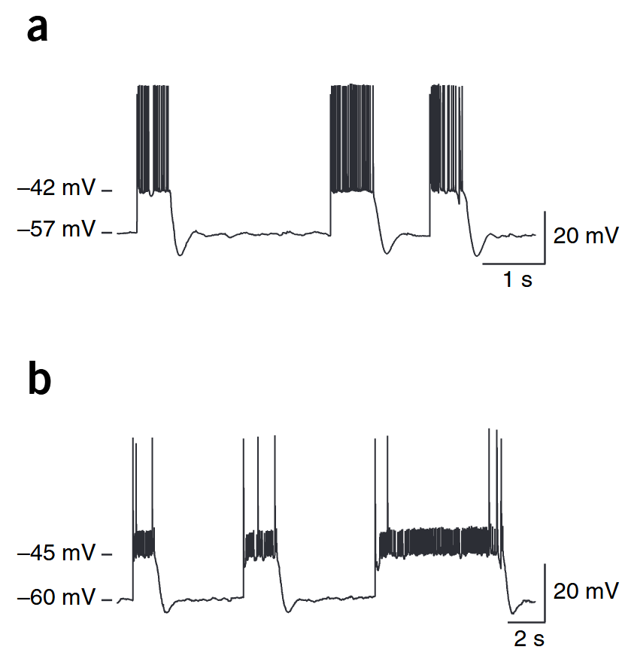

Purkinje cell’s electroresponsiveness
Bistability
(up states and down states)
Simple and complex firing
perisomatic
Presumed distal dendritic
M. Häusser, et al, Nat Neurosci, 2005
E. D'Angelo, et al, Front Cell Neurosci, 2015
Notes:
Bistability (up states and down states)
Almost linear input-output relationship with current injection until they generate complex-bursting
Can move between up and down states in certain functional conditions
A unique feature of Purkinje neurons that may enhance their vulnerability is that they are autonomous pacemaker neurons which sustain firing 40 Hz even in the absence of synaptic input [36,81]. Perturbations in ion-channel expression and function have the potential to greatly impact Purkinje neuron firing and drive motor impairment.
Purkinje neurons receive and integrate signals from several distinct neuronal pathways. Purkinje neuron intrinsic firing is modulated by synaptic activity to modify activity of downstream motor pathways. Under normal conditions, Purkinje neurons can sustain firing at a large dynamic range, up to several hundred spikes per second in vivo [100]. In order to properly transmit motor information, Purkinje neurons must be capable of fast modulation of this firing in order to encode information. There is debate as to whether Purkinje neurons use firing
Microscopically, Purkinje cells have a large, flat, highly branched dendritic tree and a single long axon that forms an inhibitory projection to the cerebellar nuclei. The plane of the dendritic tree is perpendicular to the folds in the cerebellar cortex, with parallel fibers passing through the distal dendritic trees of a large number of Purkinje cells forming weak synapses. A single climbing fiber, as noted above, makes a few hundred synapses to the soma and proximal dendrites. Any given climbing fiber is one of about ten axons from an inferior olivary cell, so the same input is distributed among multiple Purkinje cells.[6] In the 3-layered cerebellar cortex, the Purkinje cells’ bodies make up the middle Purkinje cell layer, while their dendritic trees with the parallel fibers and some of the inhibitory cells, such as basket cells, make up the outer molecular layer.

Slide 8
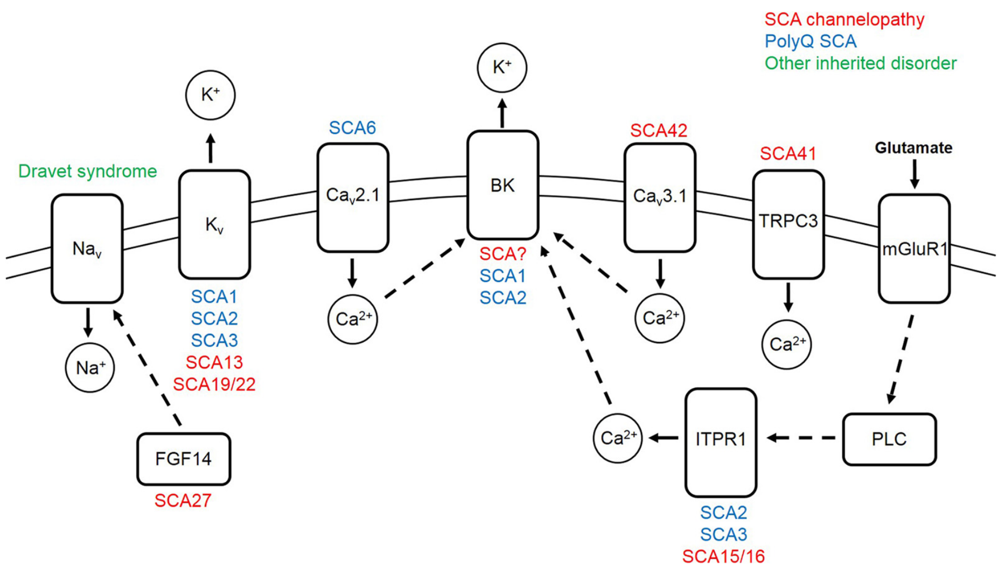
Purkinje cell & ion channel dysfunction
falling phase
TRPC3 & inositol 1,4,5-trisphosphate receptor : mediate calcium homeostasis and the modulation of cerebellar learning
CaV: coupled with KCa,
after-hyperpolarization
upstroke of AP
Bushart&Shakkottai, Neuroscience Letters, 2018
Notes:
Purkinje neuron action potentials are dependent on precise, coordinated activity of a large complement of ion-channels in order to maintain autonomous repetitive spiking. Spontaneous action potentials are driven by resurgent sodium current carried by the voltage-gated sodium channel Nav1.6 [81]. Upon reaching threshold, Nav1.6 and Nav1.1 channels become maximally activated, generating the upstroke of the action potential. The falling phase of the action potential is driven by voltage-gated potassium channels, mostly Kv3 family members [67]. Upon membrane depolarization, voltage-gated calcium channels (mainly Cav2.1 and Cav3 family members) also become activated, allowing external calcium entry into Purkinje neurons [80,97]. These voltage-gated calcium channels are tightly coupled to calciumactivated potassium channels (KCa channels), so that the net effect of calcium entry is an outward potassium current which hyperpolarizes the membrane potential [107]. The major KCa channels in Purkinje neurons are large-conductance calcium-activated potassium (BK, KCa1.1) channel and the small-conductance calcium-activated potassium (SK) channel (SK2, KCa2.2), which generate the after-hyperpolarization (AHP) [16,28,84]. The AHP is essential for de-activation of voltage-gated sodium and potassium channels, which allows for their activation during the subsequent action potential. The depolarization of the membrane potential during the interspike interval, which is necessary for autonomous spiking, is mediated by unique resurgent kinetics of voltage-gated sodium channels [81]. Finally, an assortment of subthreshold-activated potassium channels are active during the interspike interval [1,10,30,53,56,79], while other channels such as TRPC3 and the inositol 1,4,5-trisphosphate receptor play important roles mediating calcium homeostasis and the modulation of cerebellar learning [8,35,55,98]. Purkinje neurons spiking is therefore sensitive to perturbations in ion-channels, and mutations in any of these channels can cause motor dysfunction as outlined below
浦肯野神经元动作电位依赖于大量离子通道的精确、协调活动，以维持自主的重复尖峰。自发动作电位由电压门控钠通道 Nav1.6 携带的复苏钠电流驱动 [81]。达到阈值时，Nav1.6 和 Nav1.1 通道被最大限度地激活，产生动作电位的上行冲程。动作电位的下降阶段由电压门控钾通道驱动，主要是 Kv3 家族成员 [67]。膜去极化后，电压门控钙通道（主要是 Cav2.1 和 Cav3 家族成员）也被激活，允许外部钙进入浦肯野神经元 [80,97]。这些电压门控钙通道与钙激活钾通道（KCa通道）紧密耦合，因此钙进入的净效应是钾电流向外，使膜电位超极化[107]。浦肯野神经元中的主要KCa通道是大电导钙激活钾（BK，KCa1.1）通道和小电导钙激活钾（SK）通道（SK2，KCa2.2），它们产生后超极化（AHP）[16,28,84]。AHP 对于电压门控钠和钾通道的失活至关重要，这允许它们在随后的动作电位期间被激活。在间尖峰间隔期间，膜电位的去极化是自主尖峰所必需的，由电压门控钠通道独特的复苏动力学介导[81]。最后，在间刺间期期间，各种亚阈值激活的钾通道处于活动状态[1,10,30,53,56,79]，而其他通道如TRPC3和肌醇1,4,5-三磷酸受体在介导钙稳态和小脑学习调节方面发挥重要作用[8,35,55,98]。因此，浦肯野神经元的尖峰对离子通道中的扰动很敏感，这些通道中的任何一个突变都可能导致运动功能障碍
[9]. Indeed, conventional ion-channel mutations are known to result in ataxia (Table 1). In general, these channelopathies tend to present as pure cerebellar ataxia as compared to more diverse symptoms in the polyglutamine SCAs [27]. Mouse models have provided valuable insight to the functional implications of disrupted ion-channel function in many of these ataxia-causing channelopathies. These models clearly demonstrate that electrophysiologic dysfunction contribute to motor impairment in ataxia. In SCA13, point mutati

Slide 9
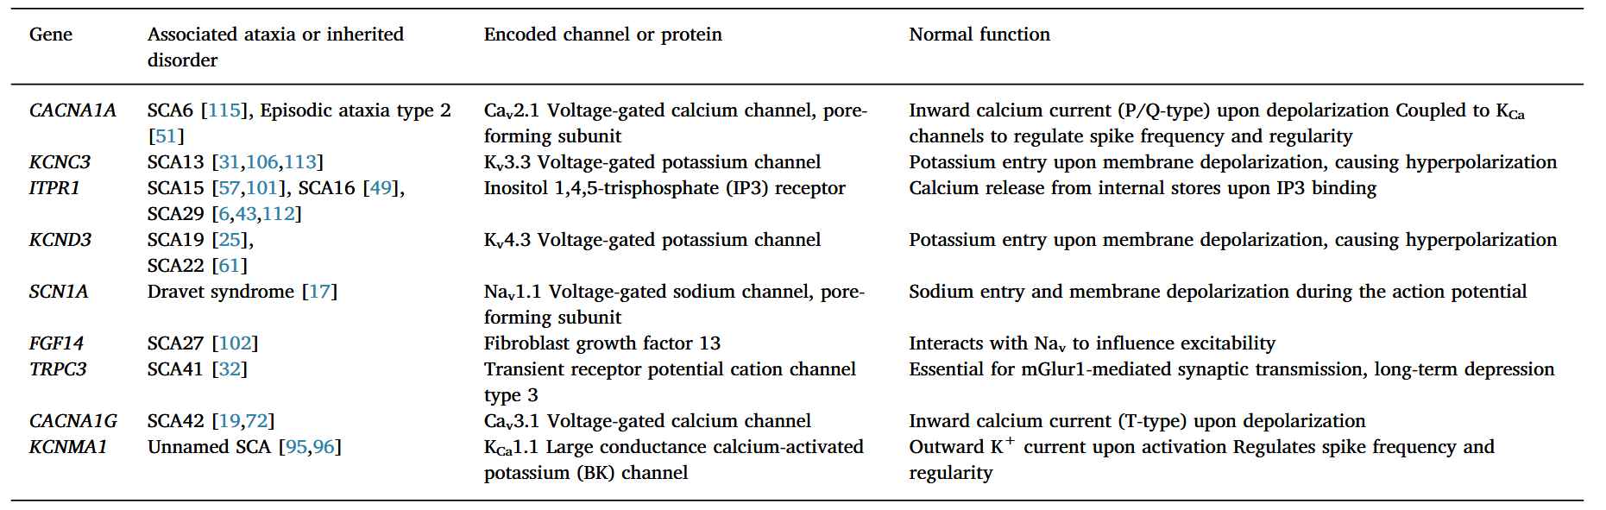
Purkinje cell & ion channel dysfunction
Bushart&Shakkottai, Neuroscience Letters, 2018
Notes:
文章《Ion channel dysfunction in cerebellar ataxia》讨论了影响浦肯野细胞并导致小脑性共济失调的各种离子通道突变和功能障碍。以下是文章中提到的离子通道功能障碍及其对浦肯野细胞的影响：1. **Cav2.1（P/Q型钙通道）**：CACNA1A基因突变会导致SCA6。这些通道对神经递质释放至关重要。功能障碍可能导致浦肯野细胞放电不规则，从而影响运动协调。2. **Kv3.3（电压门控钾通道）**：KCNC3基因突变导致SCA13。Kv3.3通道对动作电位的复极化阶段很重要。其功能障碍会导致浦肯野细胞放电频率降低和尖峰规律性改变。3. **ITPR1（肌醇1,4,5-三磷酸受体）**：ITPR1基因突变导致SCA15/16和SCA29。ITPR1参与钙信号传导。其功能障碍可能导致突触可塑性受损和运动障碍。4. **Kv4.3（A型钾通道）**：KCND3基因突变导致SCA19/22。Kv4.3通道有助于动作电位的复极化。其功能障碍可能扰乱浦肯野细胞的放电模式。5. **Nav1.1（电压门控钠通道）**：SCN1A基因突变导致Dravet综合征，可能伴有小脑性共济失调。Nav1.1通道对动作电位的起始至关重要。其功能障碍可能导致浦肯野细胞放电频率降低。6. **FGF14（成纤维细胞生长因子14）**：FGF14基因突变导致SCA27。FGF14与电压门控钠通道相互作用以调节神经元兴奋性。其功能障碍可能导致浦肯野细胞放电受阻和共济失调。7. **TRPC3（瞬时受体电位通道C3型）**：TRPC3基因突变导致SCA41。TRPC3参与突触传递，并有助于浦肯野神经元的长期抑制。其功能障碍可能导致浦肯野细胞放电异常和运动障碍。8. **Cav3.1（T型钙通道）**：CACNA1G基因突变导致SCA42。Cav3.1通道有助于钙激活钾通道的激活。其功能障碍可能影响后超极化电位的产生，降低尖峰规律性。9. **KCNMA1（BK通道）**：KCNMA1基因突变导致共济失调伴小脑萎缩。BK通道调节尖峰频率和规律性。这些通道的功能障碍可能导致浦肯野细胞膜兴奋性增加和运动障碍。文章强调，浦肯野细胞功能障碍是许多小脑性共济失调（SCA）的中心机制。它提出，离子通道调节剂可能代表一种治疗策略，用于治疗小脑性共济失调的运动功能障碍和神经退行性变。
The article "Ion channel dysfunction in cerebellar ataxia" discusses various ion channel mutations and dysfunctions that affect Purkinje cells and lead to cerebellar ataxia. Here is a summary of the ion channel dysfunctions mentioned and how they impact Purkinje cells:1. **Cav2.1 (P/Q-type Calcium Channel)**: Mutations in the CACNA1A gene, which encodes the Cav2.1 channel, can cause SCA6. These channels are crucial for neurotransmitter release. Dysfunction in these channels can lead to irregular Purkinje cell firing, which impairs motor coordination.2. **Kv3.3 (Voltage-gated Potassium Channel)**: Mutations in the KCNC3 gene lead to SCA13. Kv3.3 channels are important for the repolarization phase of action potentials. Their dysfunction results in reduced firing frequency and altered spike regularity in Purkinje cells.3. **ITPR1 (Inositol 1,4,5-trisphosphate Receptor)**: Mutations in ITPR1 cause SCA15/16 and SCA29. ITPR1 is involved in calcium signaling. Its dysfunction can lead to impaired synaptic plasticity and motor impairment.4. **Kv4.3 (A-type Potassium Channel)**: Mutations in the KCND3 gene result in SCA19/22. Kv4.3 channels contribute to the repolarization of action potentials. Their dysfunction can disrupt Purkinje cell firing patterns.5. **Nav1.1 (Voltage-gated Sodium Channel)**: Mutations in SCN1A cause Dravet syndrome, which can be accompanied by cerebellar ataxia. Nav1.1 channels are essential for the initiation of action potentials. Their dysfunction can lead to reduced Purkinje cell firing frequency.6. **FGF14 (Fibroblast Growth Factor 14)**: Mutations in FGF14 cause SCA27. FGF14 interacts with voltage-gated sodium channels to modulate neuronal excitability. Its dysfunction can result in disrupted Purkinje cell firing and ataxia.7. **TRPC3 (Transient Receptor Potential Channel Type C3)**: Mutations in TRPC3 cause SCA41. TRPC3 is involved in synaptic transmission and contributes to long-term depression in Purkinje neurons. Its dysfunction can lead to abnormal Purkinje cell firing and motor impairment.8. **Cav3.1 (T-type Calcium Channel)**: Mutations in CACNA1G, which encodes Cav3.1, cause SCA42. Cav3.1 channels contribute to calcium-dependent potassium channel activation. Their dysfunction can affect the generation of after-hyperpolarization (AHP) and reduce spike regularity in Purkinje cells.9. **KCNMA1 (BK Channel)**: A mutation in KCNMA1 causes ataxia with cerebellar atrophy. BK channels regulate spike frequency and regularity. Dysfunction in these channels can lead to increased Purkinje cell membrane excitability and motor impairment.The article emphasizes that Purkinje cell dysfunction is a central mechanism in many etiologies of spinocerebellar ataxia (SCA). It suggests that ion channel modulators may represent a therapeutic strategy for both motor dysfunction and neurodegeneration in cerebellar ataxia.
Purkinje neuron action potentials are dependent on precise, coordinated activity of a large complement of ion-channels in order to maintain autonomous repetitive spiking. Spontaneous action potentials are driven by resurgent sodium current carried by the voltage-gated sodium channel Nav1.6 [81]. Upon reaching threshold, Nav1.6 and Nav1.1 channels become maximally activated, generating the upstroke of the action potential. The falling phase of the action potential is driven by voltage-gated potassium channels, mostly Kv3 family members [67]. Upon membrane depolarization, voltage-gated calcium channels (mainly Cav2.1 and Cav3 family members) also become activated, allowing external calcium entry into Purkinje neurons [80,97]. These voltage-gated calcium channels are tightly coupled to calciumactivated potassium channels (KCa channels), so that the net effect of calcium entry is an outward potassium current which hyperpolarizes the membrane potential [107]. The major KCa channels in Purkinje neurons are large-conductance calcium-activated potassium (BK, KCa1.1) channel and the small-conductance calcium-activated potassium (SK) channel (SK2, KCa2.2), which generate the after-hyperpolarization (AHP) [16,28,84]. The AHP is essential for de-activation of voltage-gated sodium and potassium channels, which allows for their activation during the subsequent action potential. The depolarization of the membrane potential during the interspike interval, which is necessary for autonomous spiking, is mediated by unique resurgent kinetics of voltage-gated sodium channels [81]. Finally, an assortment of subthreshold-activated potassium channels are active during the interspike interval [1,10,30,53,56,79], while other channels such as TRPC3 and the inositol 1,4,5-trisphosphate receptor play important roles mediating calcium homeostasis and the modulation of cerebellar learning [8,35,55,98]. Purkinje neurons spiking is therefore sensitive to perturbations in ion-channels, and mutations in any of these channels can cause motor dysfunction as outlined below
[9]. Indeed, conventional ion-channel mutations are known to result in ataxia (Table 1). In general, these channelopathies tend to present as pure cerebellar ataxia as compared to more diverse symptoms in the polyglutamine SCAs [27]. Mouse models have provided valuable insight to the functional implications of disrupted ion-channel function in many of these ataxia-causing channelopathies. These models clearly demonstrate that electrophysiologic dysfunction contribute to motor impairment in ataxia. In SCA13, point mutati

Slide 10
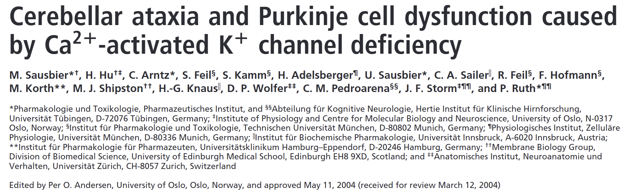
Simulation

Slide 11
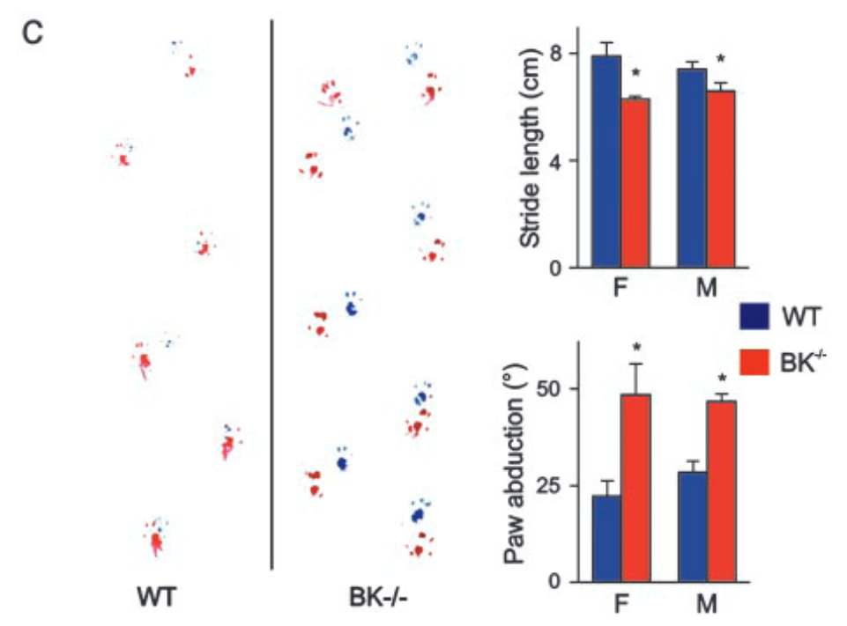
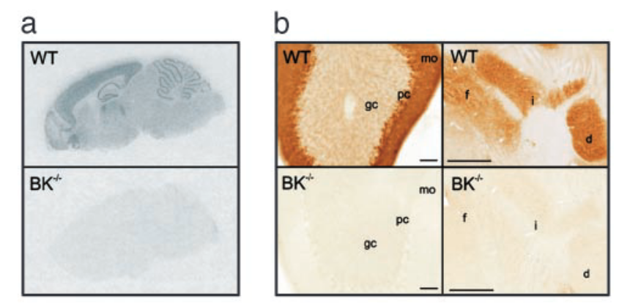
BK channel (KCa1.1) expression in brain and footprint pattern
P.Ruth, PNAS, 2004
Notes:
Analysis of BK channel expression in brain and footprint pattern of WT and BK/ mice. (a) Autoradiogram of brain sagittal sections from BK/ and BK/ mice hybridized in situ with BK channel subunit probe. (b) Immunohistochemical detection of BK channels in mouse cerebellar coronal sections: dense BK immunostaining in the molecular layer (mo), PC somata (pc), and DCN: fastigial (f), interpositus (i), dentate (d) nucleus; weak staining in granule cells (gc) layer. BK/ sections incubated in parallel showed no staining. [Bars 60 m (on the left); 400 m (on the right).] (c) Abnormal gait in BK/ mice. Footprints of 4-month-old WT and BK/ siblings (blue, forepaws; red, hindpaws). Statistics of stride length and paw abduction for males (M) and females (F). Three values were obtained from each run, excluding beginning and end; n 6 WT and 7 BK/ per gender.
BK / 小鼠的运动障碍。BK / 小鼠表现出意向性震颤和异常步态 （12）。因此，与 WT 小鼠相比，突变小鼠表现出更短的步幅和不规则的步幅模式（图 1c）。左右后爪轴之间的角度几乎翻了一番，而 WT 和突变体之间的后爪宽度相似。这些改变在所有年龄段和性别中都可见。 运动障碍排除了常见的空间学习测试，例如水迷宫。因此，突变体表现出游泳速度降低和更频繁的漂浮。为了测试运动协调和平衡，我们使用了光束行走 （12）。BK / 小鼠不愿意穿过横梁（图 2a），如果尝试，它们会犯更多的滑倒和后爪错误，并且经常从横梁上或从起始平台上掉下来，从而表明严重的运动障碍。在加速旋转测试中，该测试也需要良好的感觉运动协调性，并且对小脑和基底神经节功能障碍敏感 （11），两性的 BK / 小鼠都显示出明显降低的跌倒潜伏期（图 2b）。 尽管从低得多的水平开始，但突变体在

Slide 12
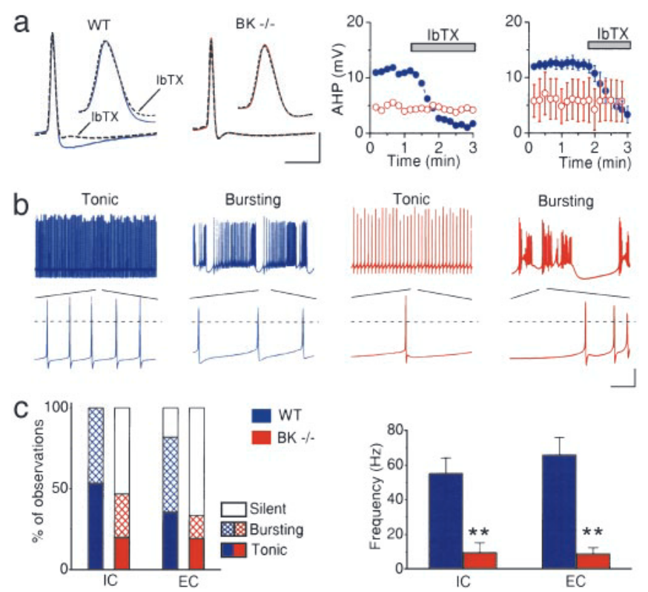
Experimental Observation
Initial voltage: -60 to -70 mV
Evoke APs by depolarizing current pulses.
P.Ruth, PNAS, 2004
Notes:
To suppress spontaneous discharge and ensure comparable recording conditions, we maintained the pretest membrane potential at a constant level (60 to 70 mV) by direct current injection, and evoked APs by depolarizing current pulses.

Slide 13
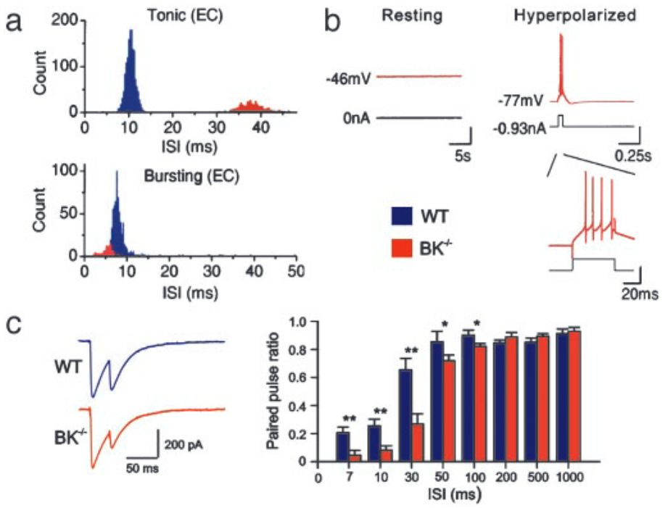
Experimental Observation
depolarized level (-45 to -50 mV), no AP
hyperpolarized to -70 or -80 mV
paired-pulse depression
P.Ruth, PNAS, 2004
Notes:
如果 BK 通道有助于突触前 AP 或 AHP，则神经递质释放的差异在高频激活期间可能会变得明显，对应于体内 PC 的高发射频率。因此，我们使用配对刺激来测试 PC DCN 突触传输的频率依赖性。如图 4c 所示，在正常 PC （32） 中也可见的双脉冲抑制在 BK / 小鼠的 DCN 中显着增加，但仅限于短于 100 毫秒的间隔。因此，BK 通道显然调节高频突触传递。可能，BK 通道的缺失损害了第一次尖峰后的复极化和/或 AHP，从而导致 Na 通道不完全失活，降低随后的尖峰振幅和 Ca2 内流，从而导致突触抑制。综上所述，PC DCN 突触的减弱传递和 PC 活性的降低有望协同减少小脑皮层的 GABA 能流出，从而导致 DCN 的去抑制，这反过来又可以解释观察到的运动缺陷
To suppress spontaneous discharge and ensure comparable recording conditions, we maintained the pretest membrane potential at a constant level (60 to 70 mV) by direct current injection, and evoked APs by depolarizing current pulses.

Slide 14
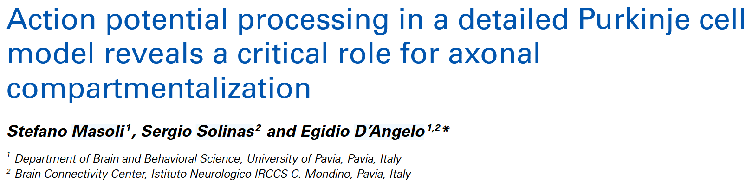
Model – a detailed Purkinje Cell Model

Slide 15
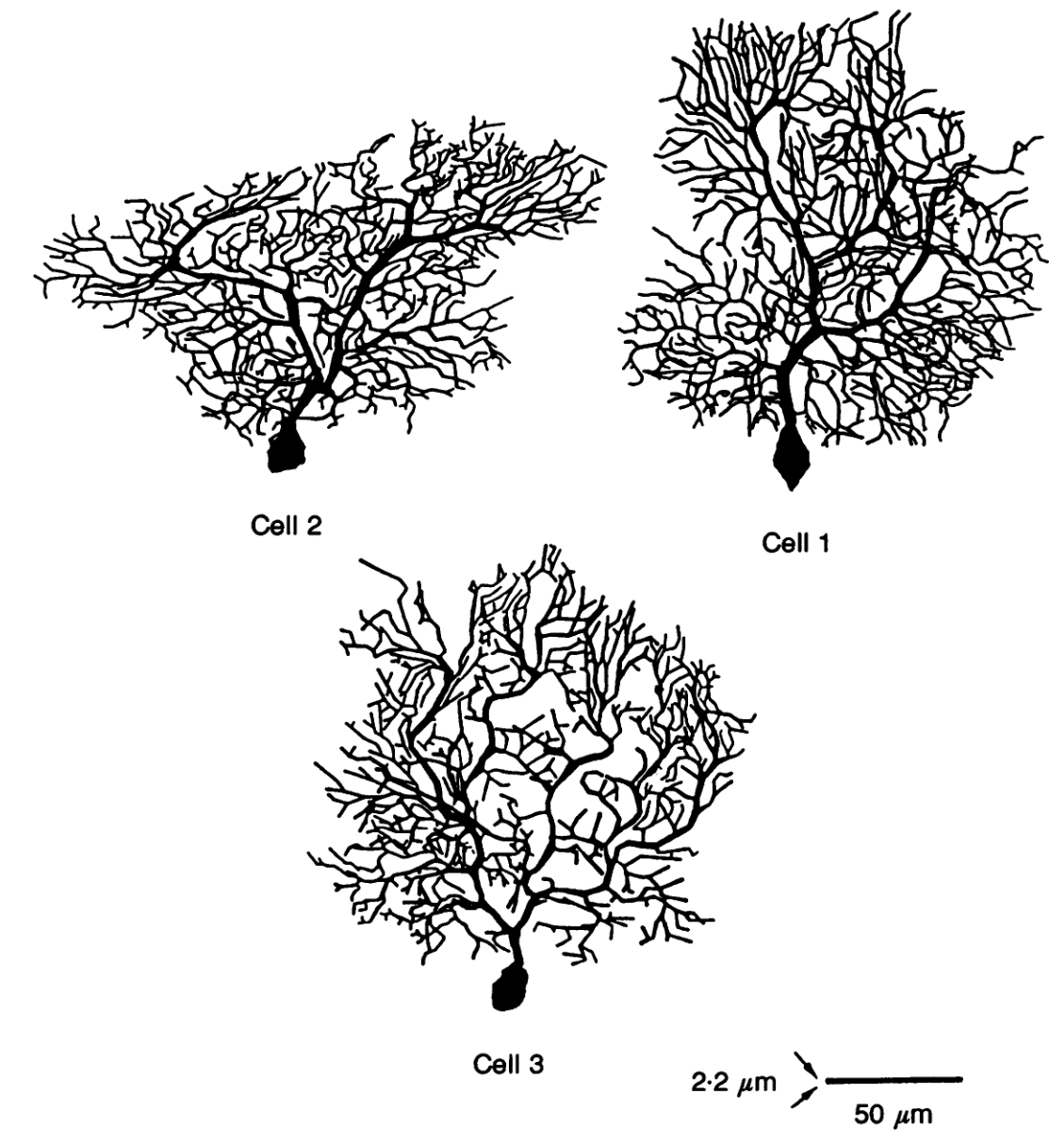
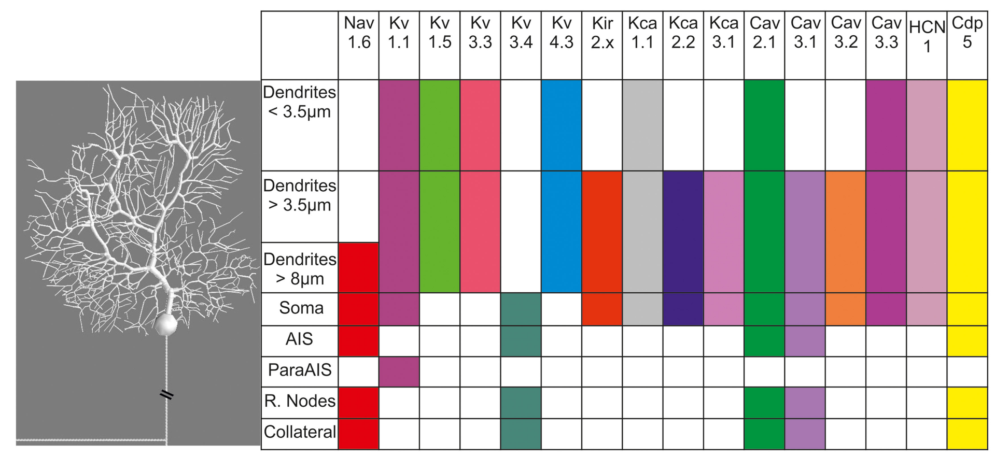
Model - 2–3 months old Guinea pig
Y. Yarom, et al, J. Physiol, 1994
M. Stefano, et al, Front Cell Neurosci, 2015
Notes:
The axon was implemented through four myelinated 100 μm compartments with 0.73 μm diameter, without any channels, and three RNs of 4 μm with 0.73 μm diameter endowed with a mixture of sodium and potassium channels (juxtaparanodes surrounding the RNs were not represented). During late morphogenesis the main axon generates a non-myelinated collateral 150–200 μm away from the soma (Clark et al., 2005; Sotelo and Rossi, 2013) which, for a short period during development, connects PCs on the horizontal plane (Maex and Steuber, 2013). This collateral has been also observed in adults healthy humans and proved five times more abundant in cases of “essential tremor” (Babij et al., 2013). Our model included a non-myelinated axonal collateral made of 2 identical 100 μm compartments with 0.6 μm diameter originating from the second RN.
There is some evidence that ataxia-related genes may cluster around pathways involving calcium homeostasis, synaptic integration, and membrane excitability [9]. Many of these potential ataxia-related genes show enriched expression in cerebellar Purkinje neurons, suggesting that not only are these pathways particularly important for cerebellar function, but also that Purkinje neuron dysfunction likely plays a central role in motor dysfunction in ataxia [9]. Indeed, conventional ion-channel mutations are known to result in ataxia (Table 1). In general, these channelopathies tend to present as pure cerebellar ataxia as compared to more diverse symptoms in the polyglutamine SCAs [27]. Mouse models have provided valuable insight to the functional implications of disrupted ion-channel function in many of these ataxia-causing channelopathies. These models clearly demonstrate that electrophysiologic dysfunction contribute to motor impairment in ataxia.

Slide 16
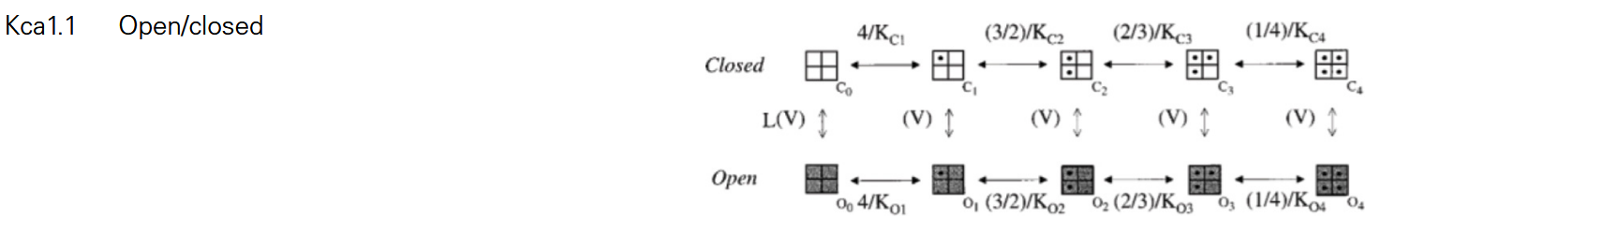
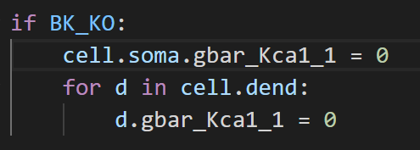
BK (KCa1.1) Channel
M. Stefano, et al, Front Cell Neurosci, 2015
Notes:
BK通道的工作原理涉及到其对细胞内钙离子浓度的敏感性以及对膜电位变化的响应。当细胞内钙离子浓度升高或膜电位变正时，BK通道会打开，允许钾离子顺电化学势梯度流出细胞，导致细胞膜电位变得更负，这一过程称为超极化。这种超极化有助于调节细胞的静息膜电位和动作电位的形状，控制神经元的放电频率和心肌细胞的收缩强度等生理过程

Slide 17
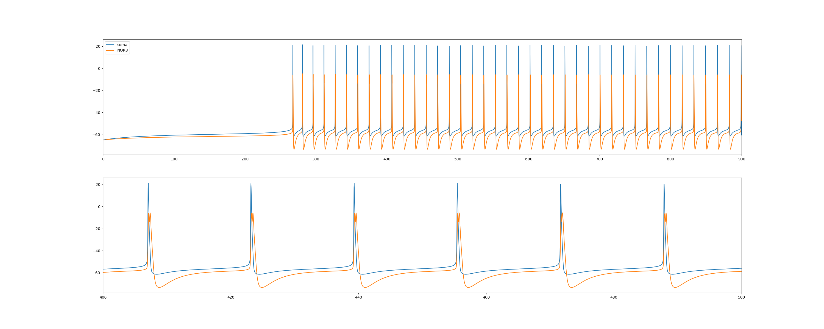
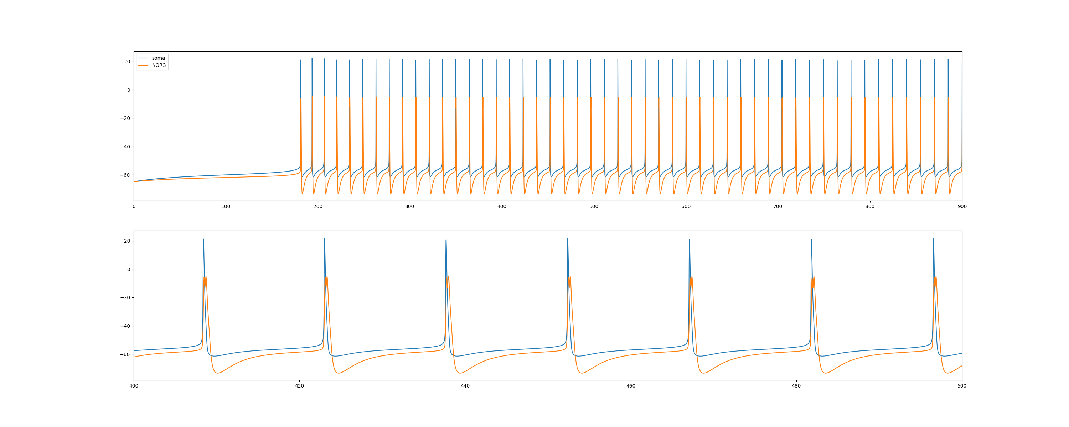
Result – spontaneous firing
Left: Normal; Right: BK KO
Notes:
主要区别在于频率，后面的结果没有显著区别

Slide 18
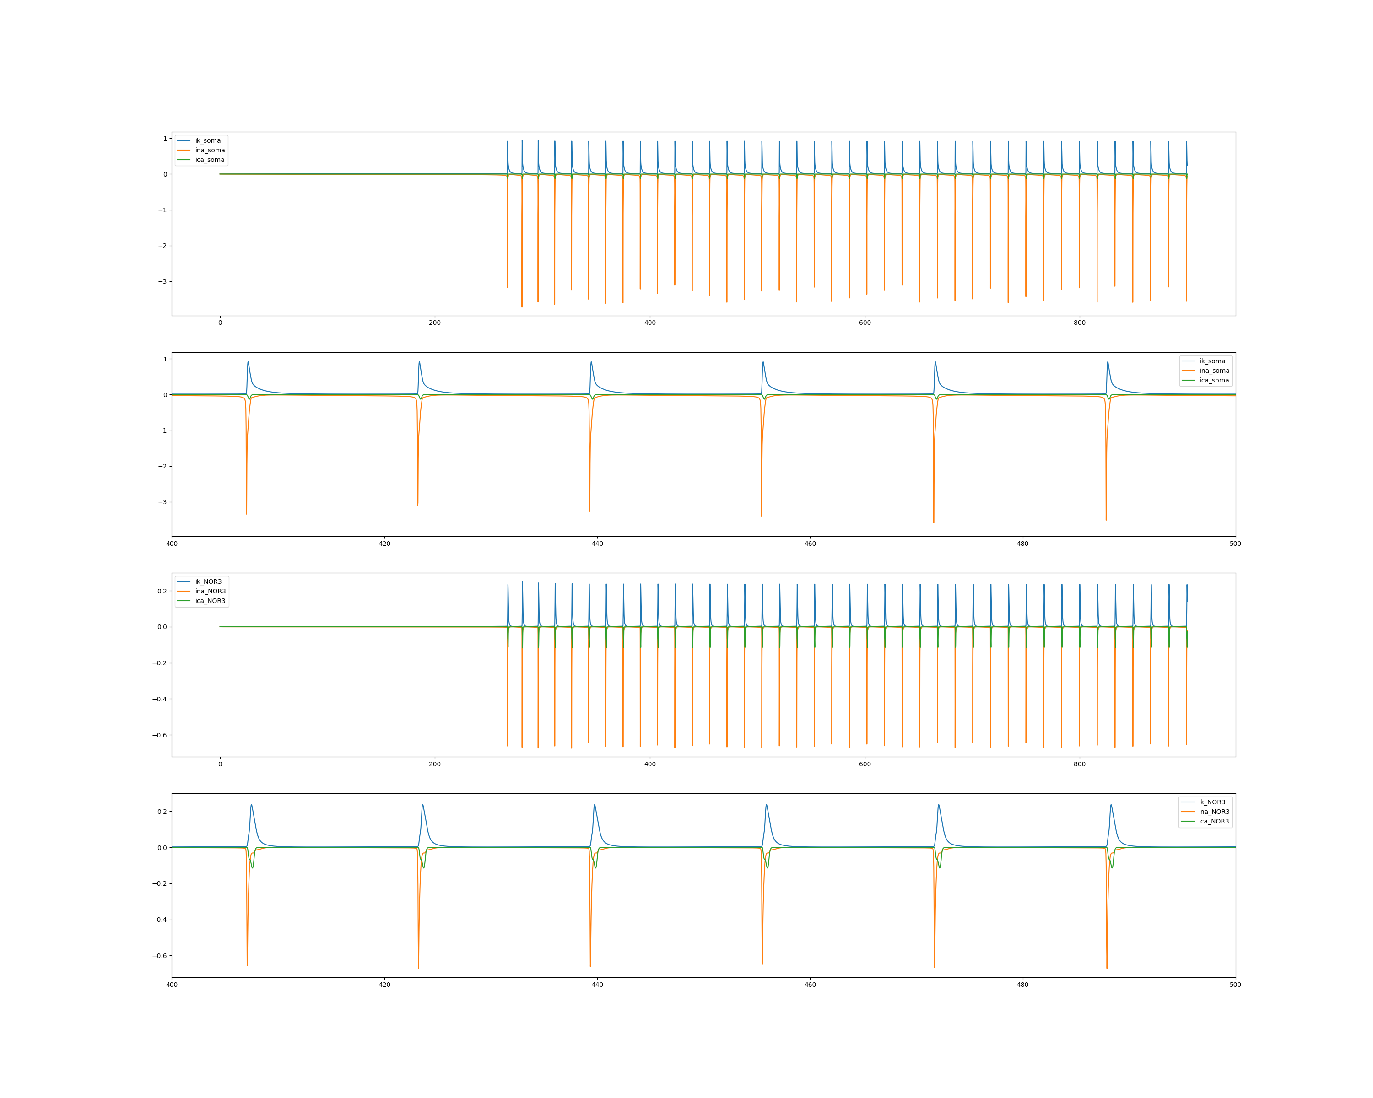
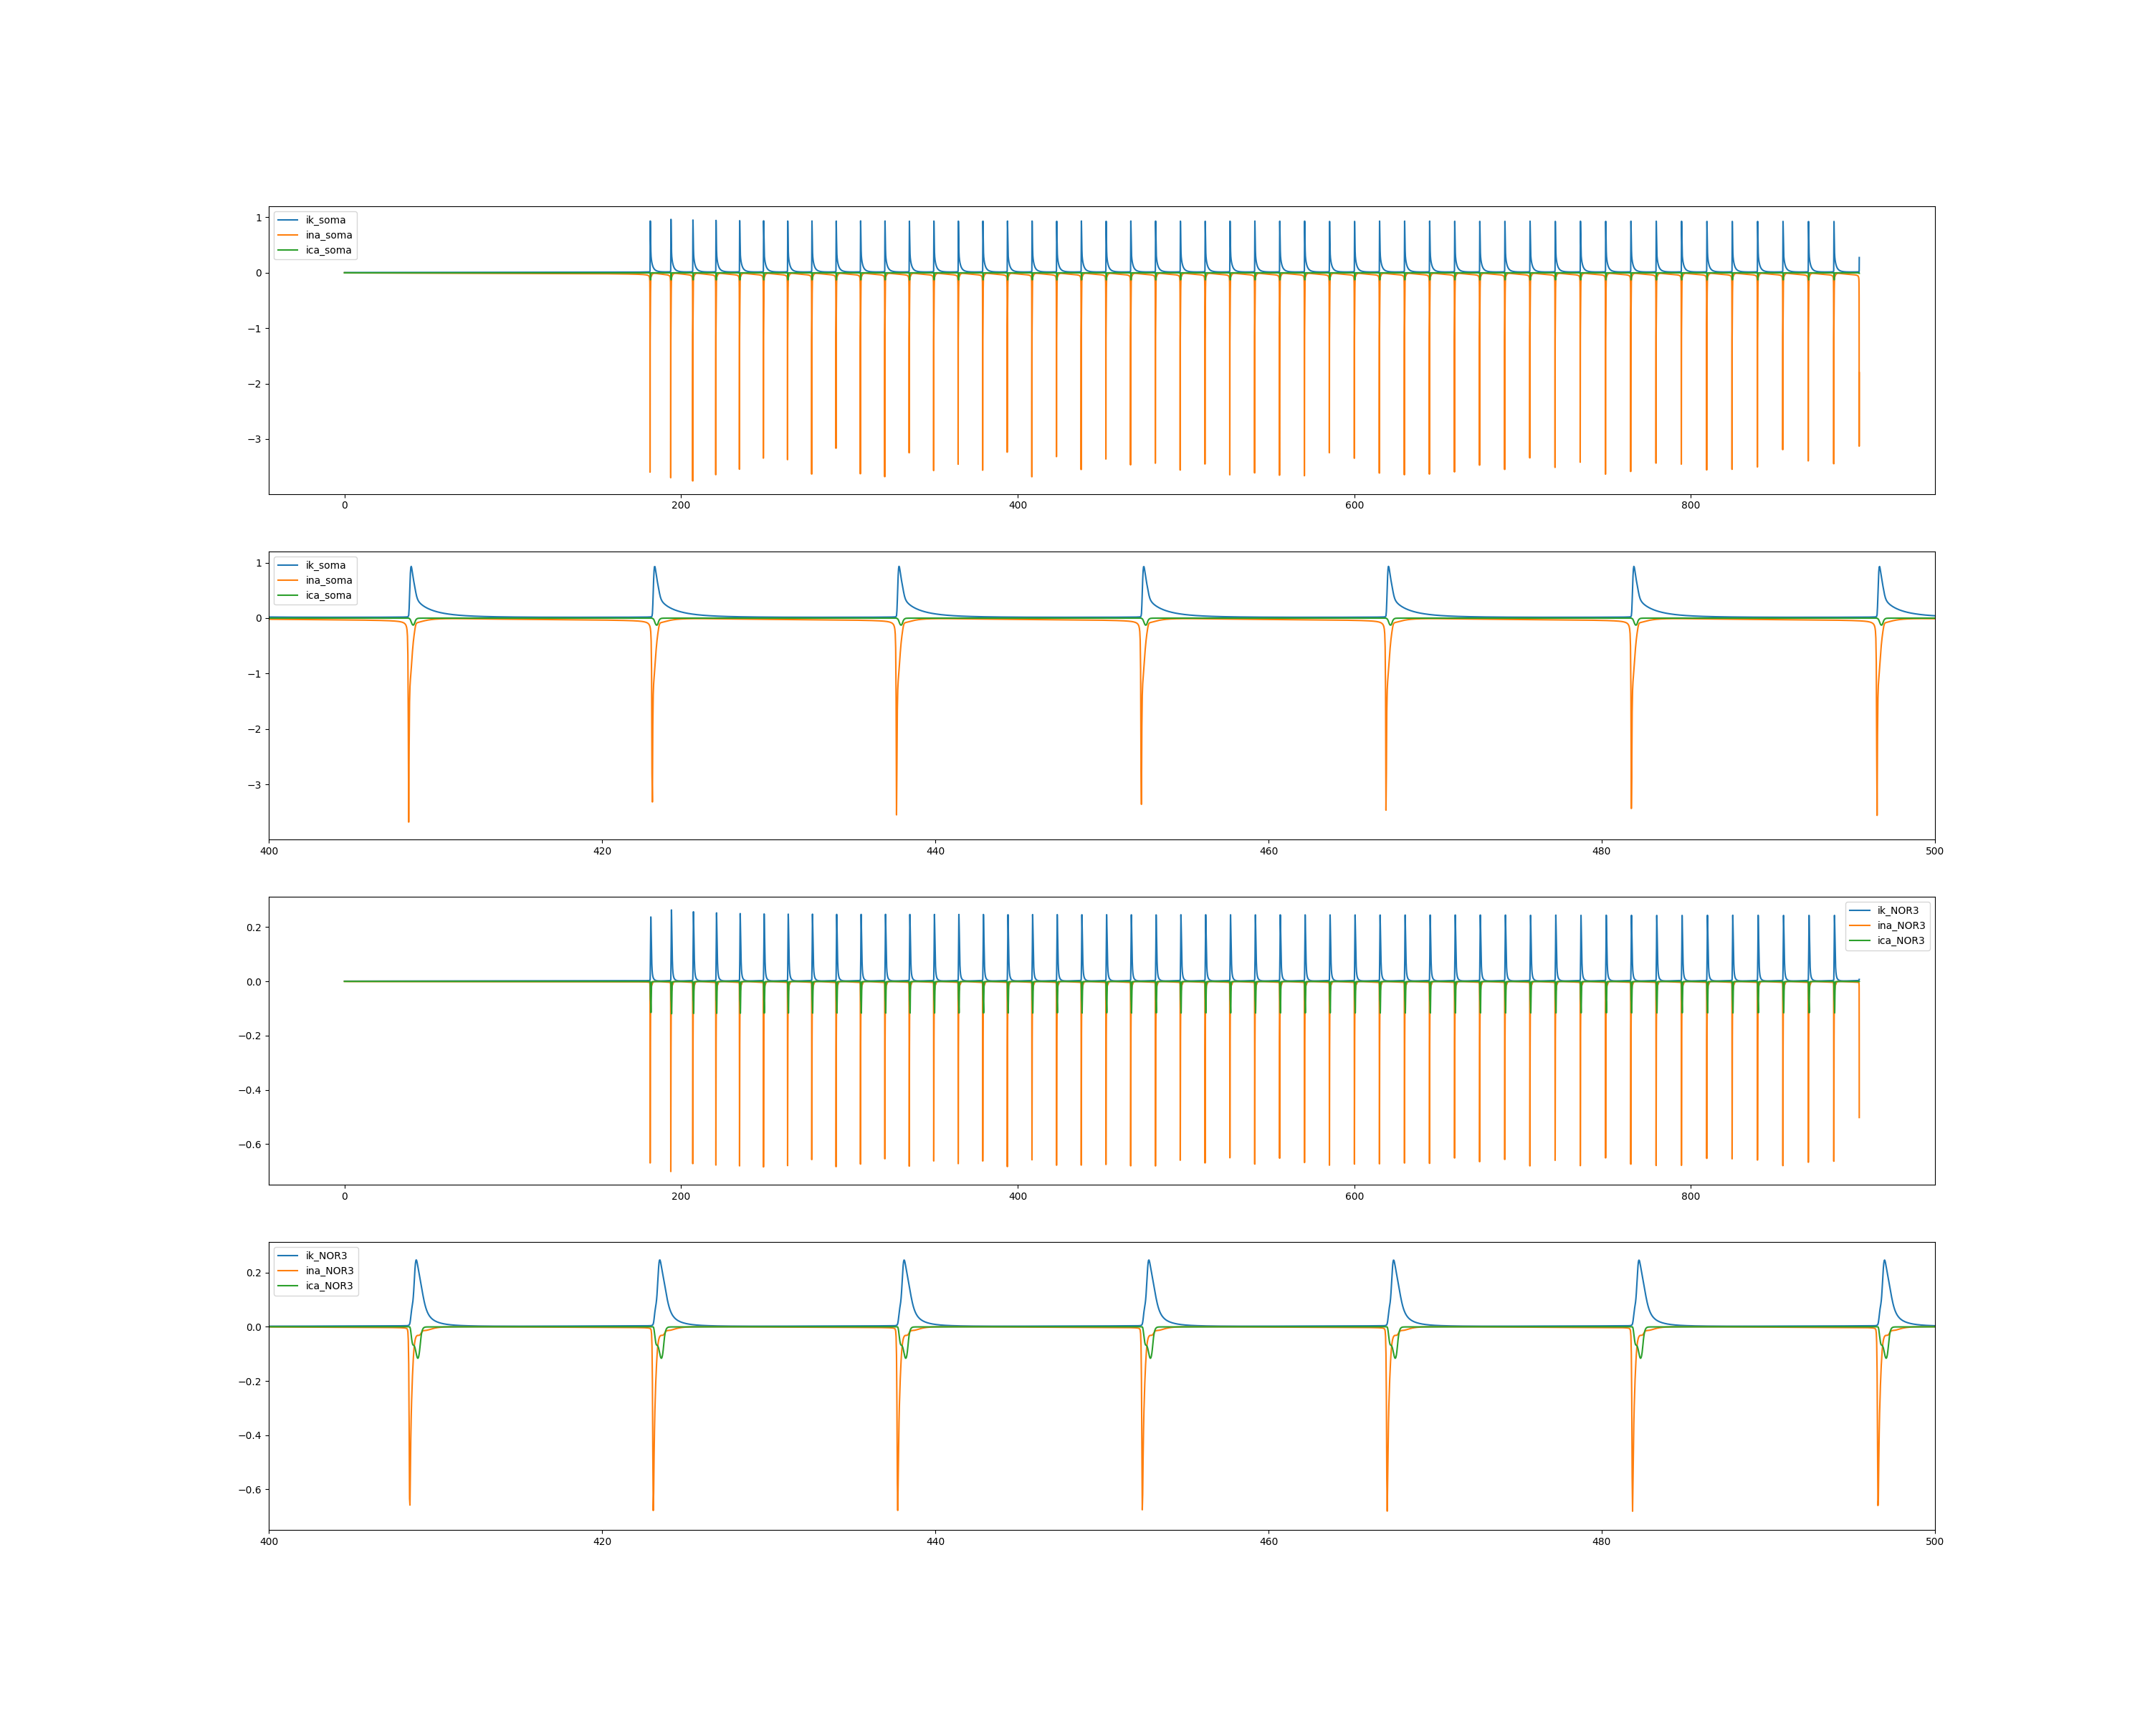
Result – spontaneous firing
Left: Normal; Right: BK KO

Slide 19
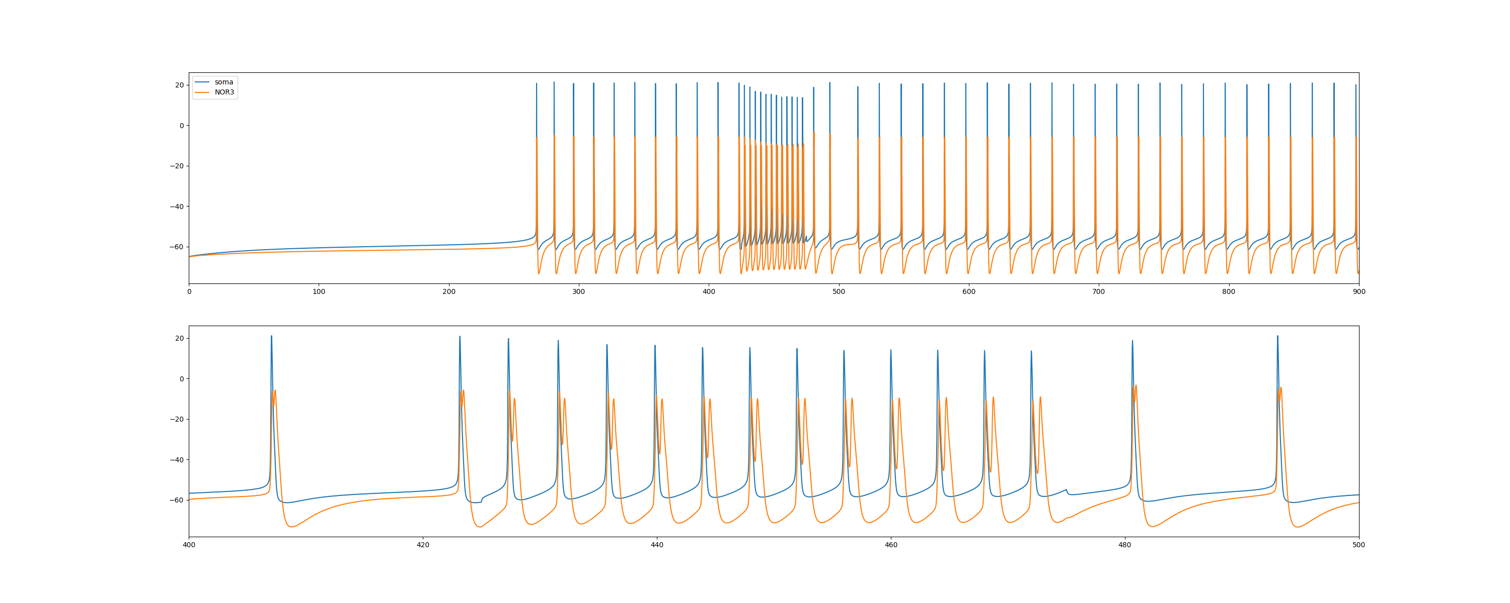
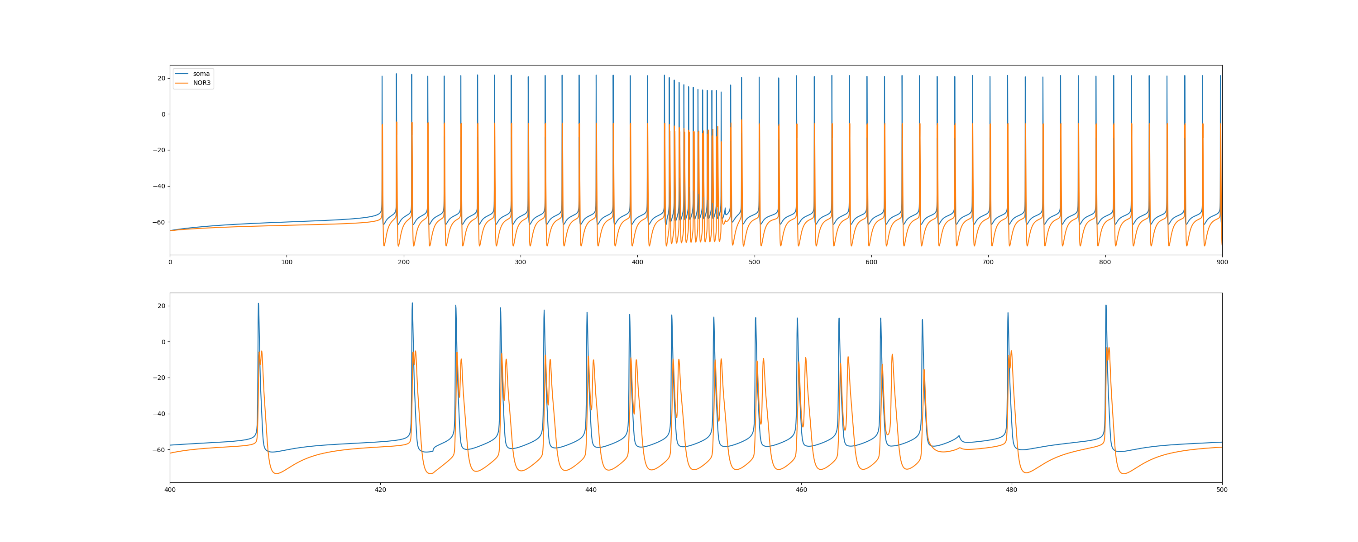
Result – step current (1.2nA, 50ms)
Left: Normal; Right: BK KO

Slide 20
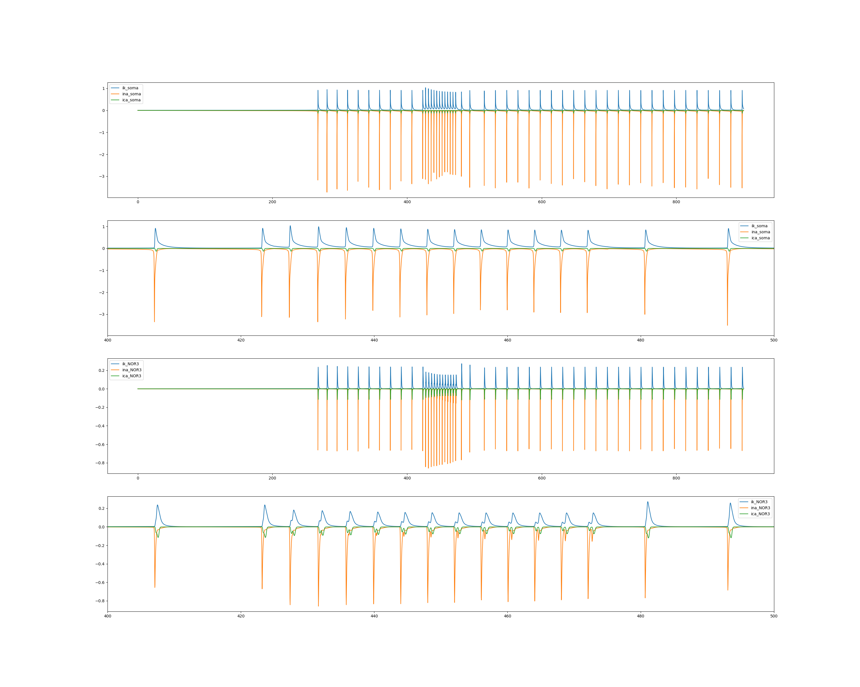
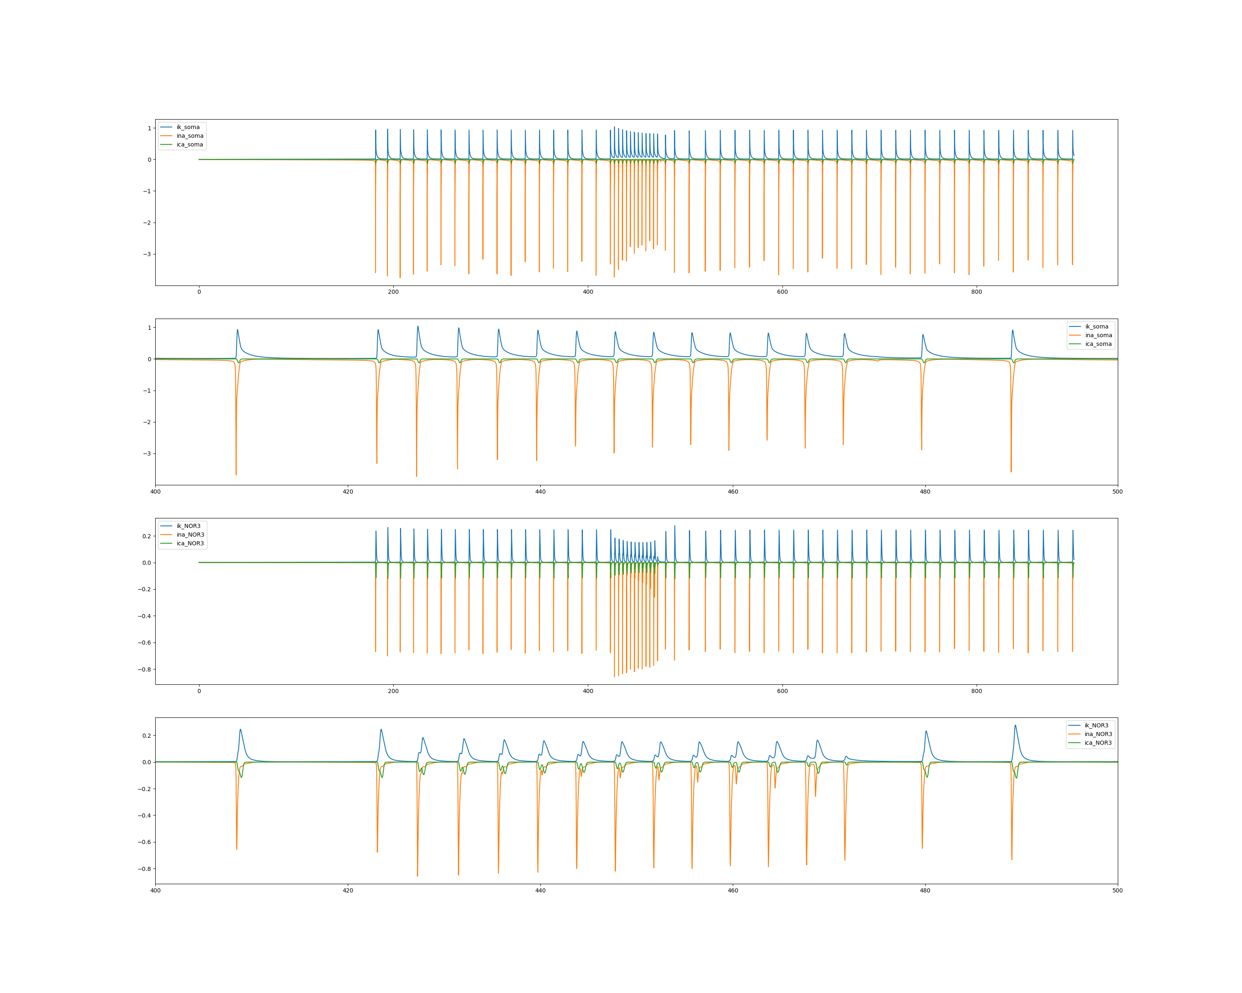
Result – step current (1.2nA, 50ms)
Left: Normal; Right: BK KO

Slide 21
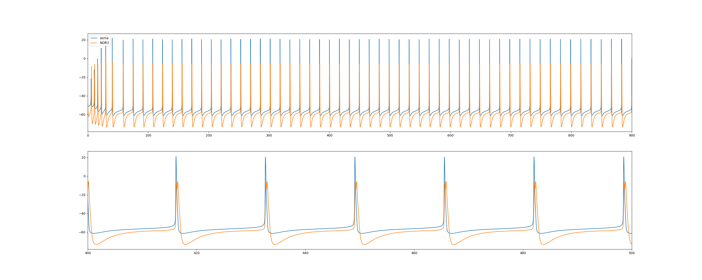
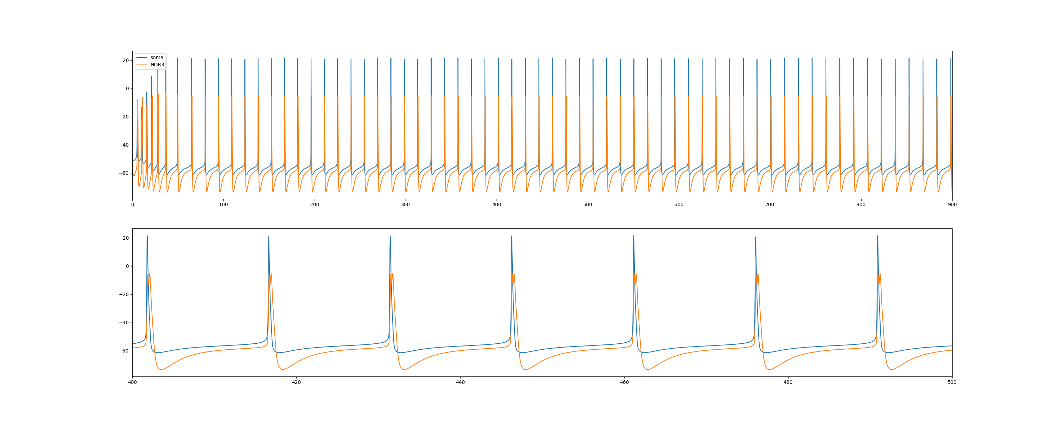
Result – initial voltage = -46mV
Left: Normal; Right: BK KO

Slide 22
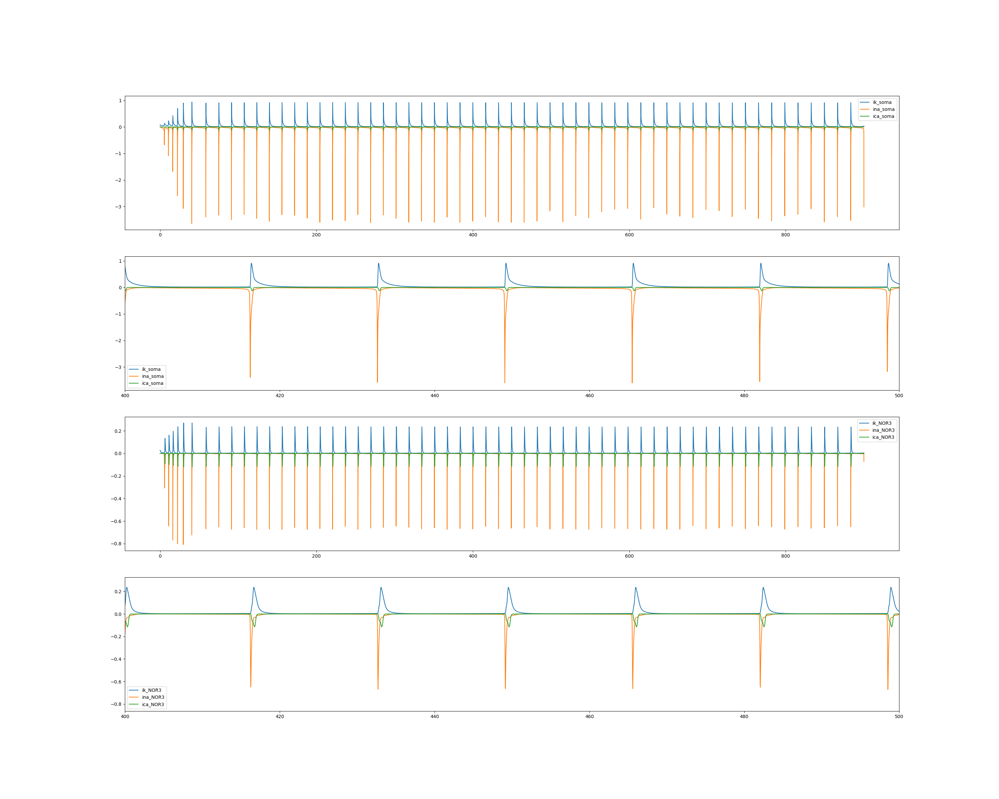
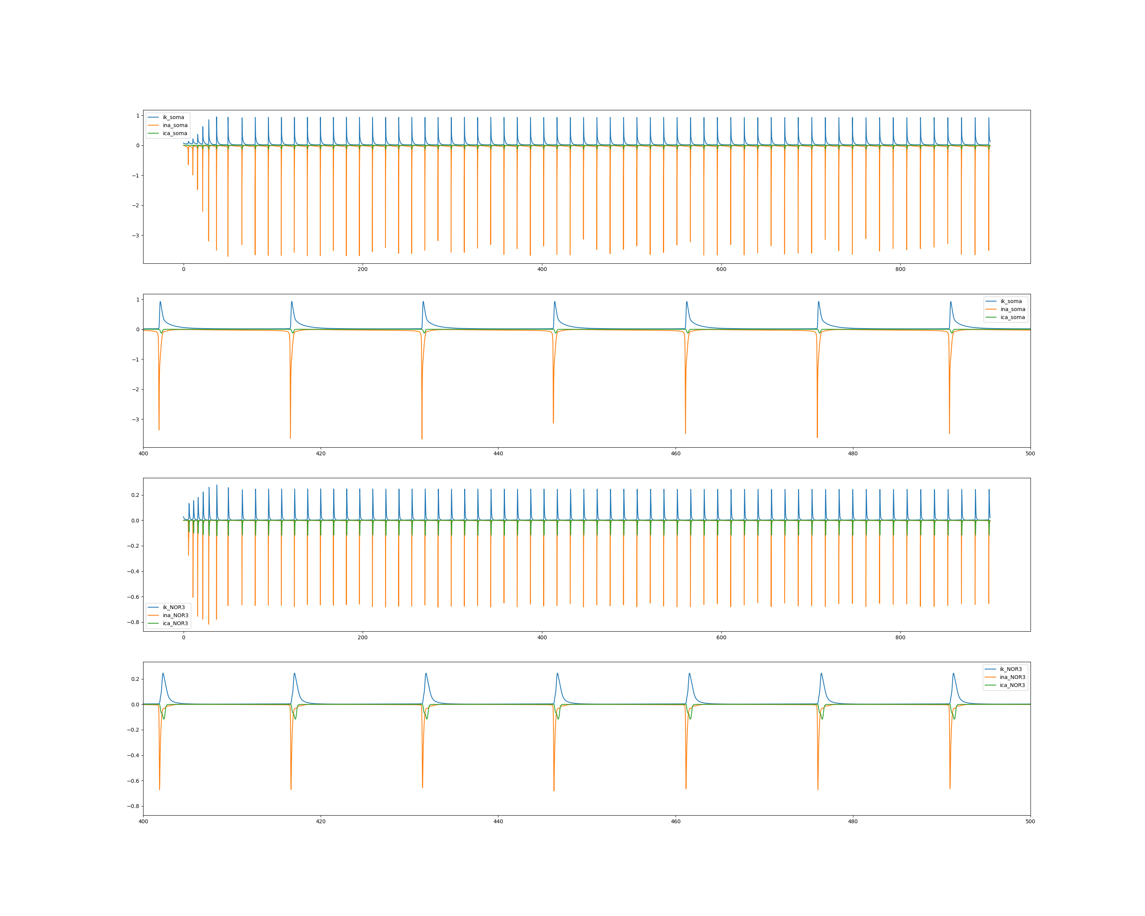
Result – initial voltage = -46mV
Left: Normal; Right: BK KO

Slide 23
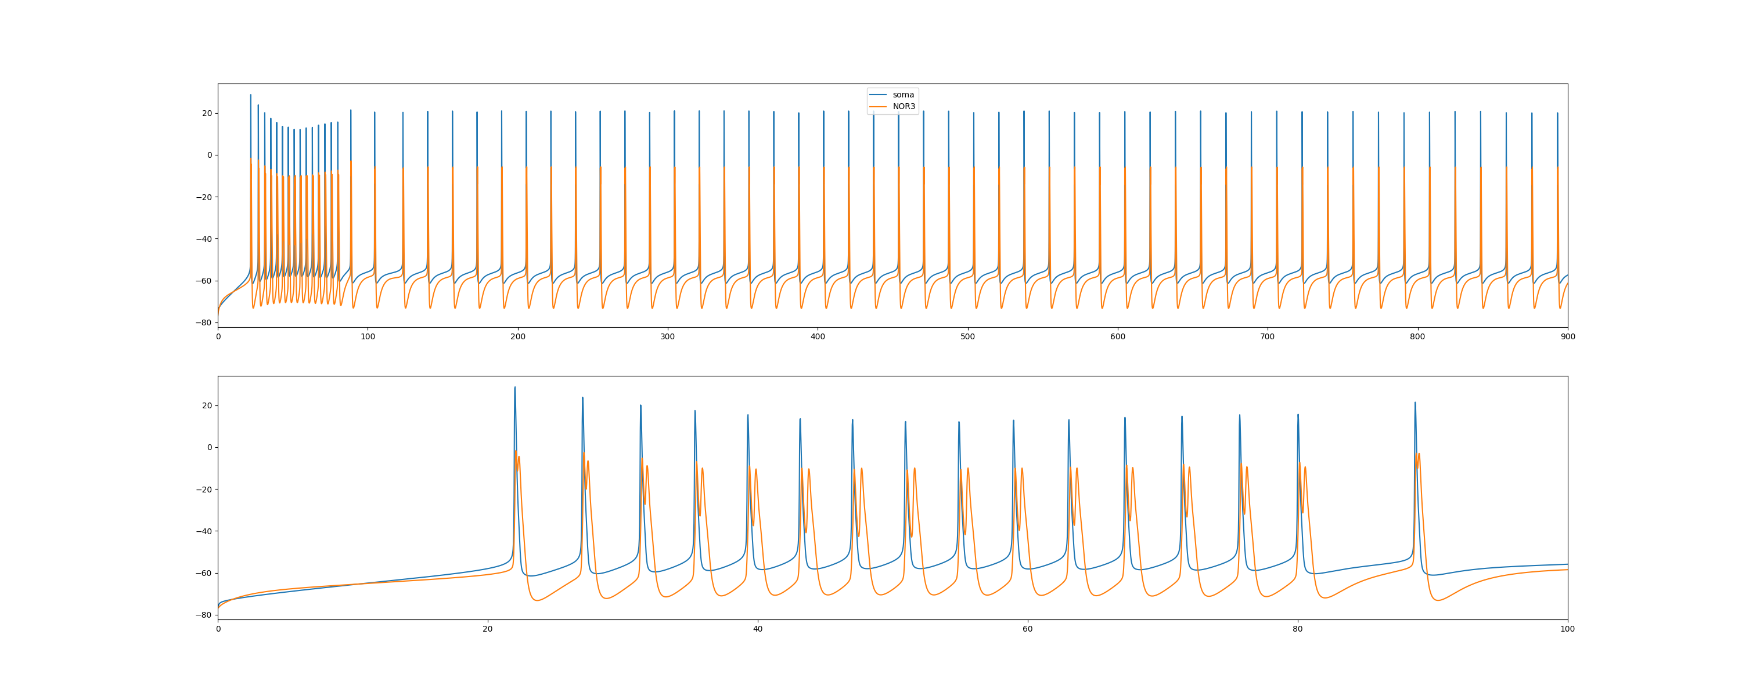
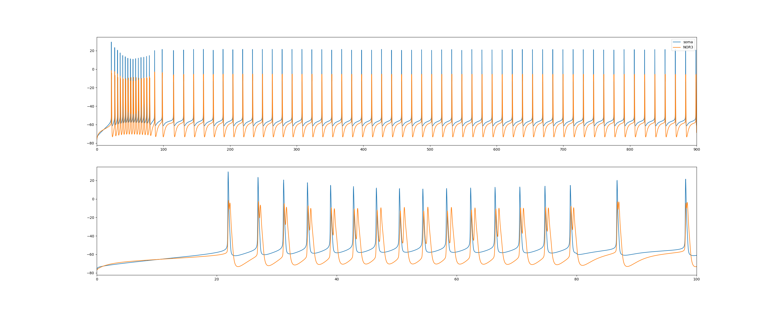
Result – initial voltage = -77mV, I = 0.93nA
Left: Normal; Right: BK KO

Slide 24
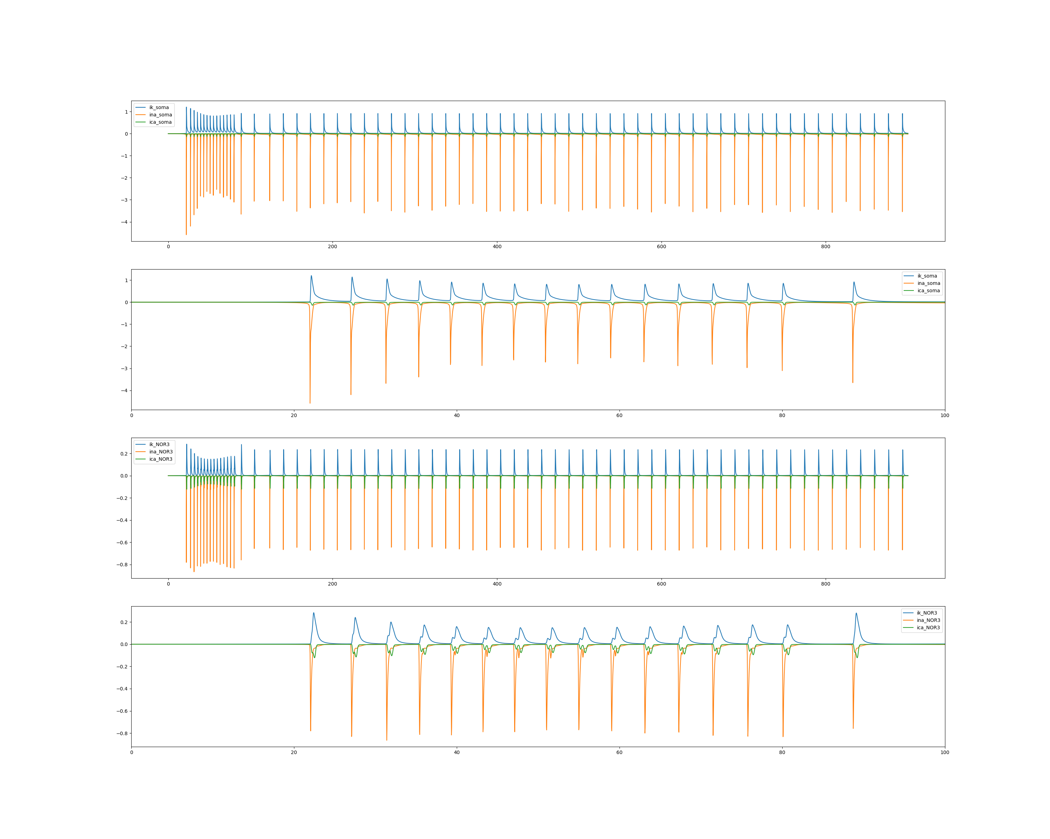
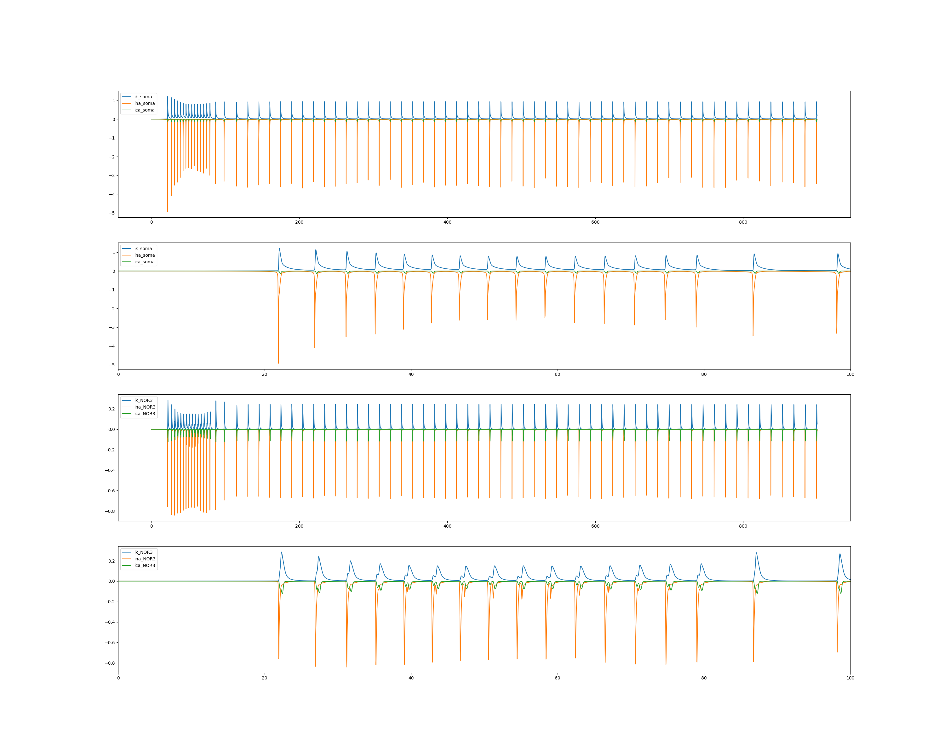
Result – initial voltage = -77mV , I = 0.93nA
Left: Normal; Right: BK KO

Slide 25
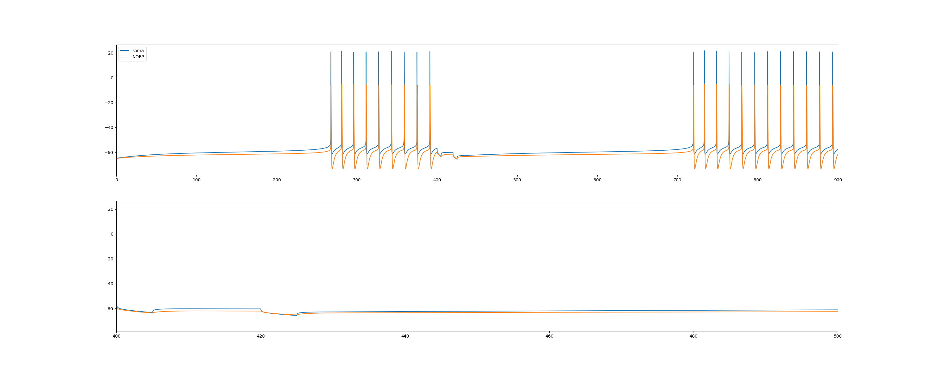
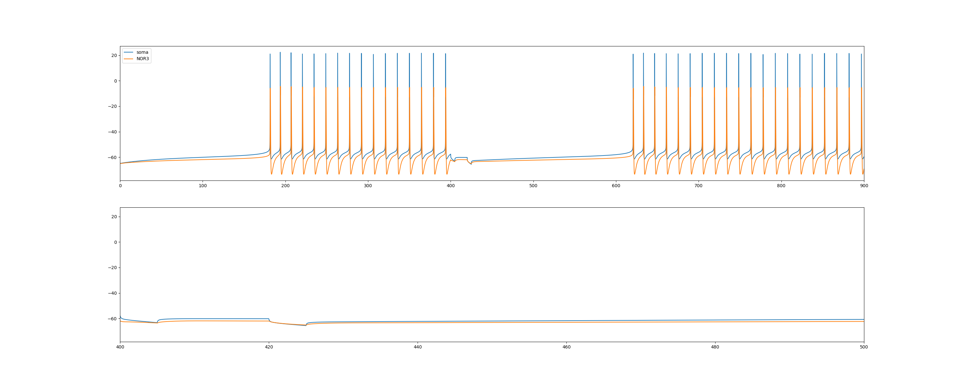
Result – paired pulse depression
Left: Normal; Right: BK KO

Slide 26
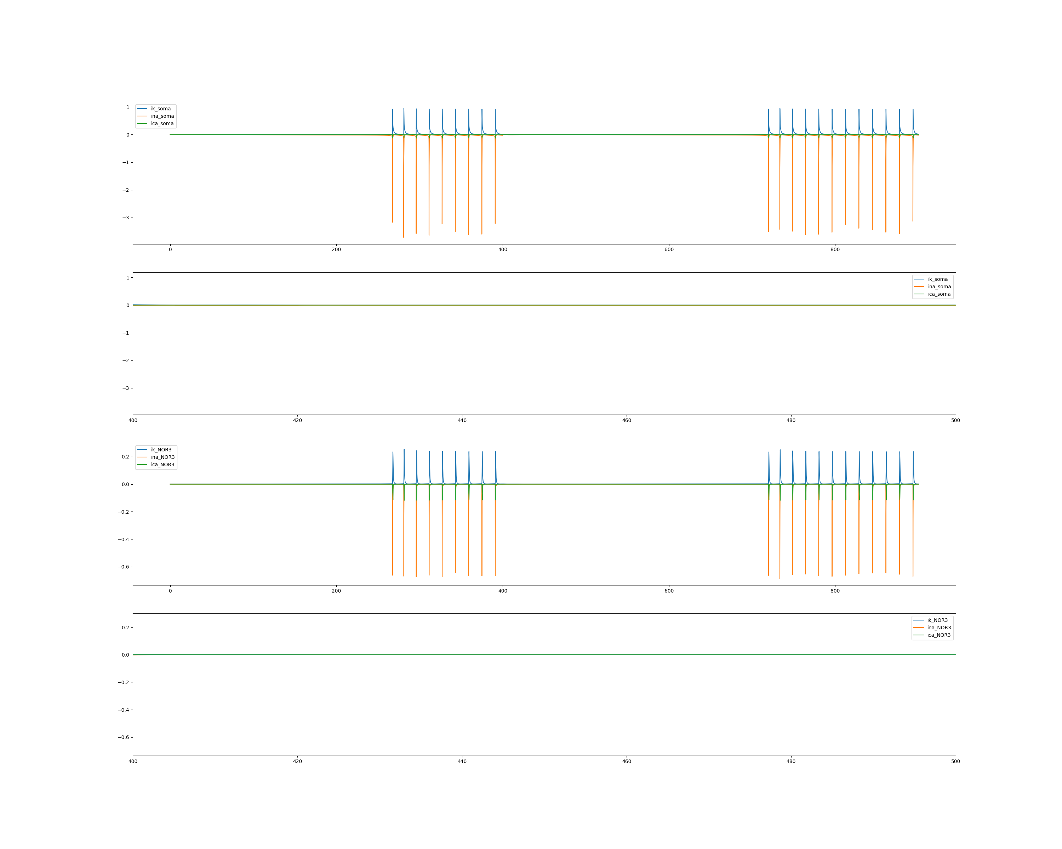
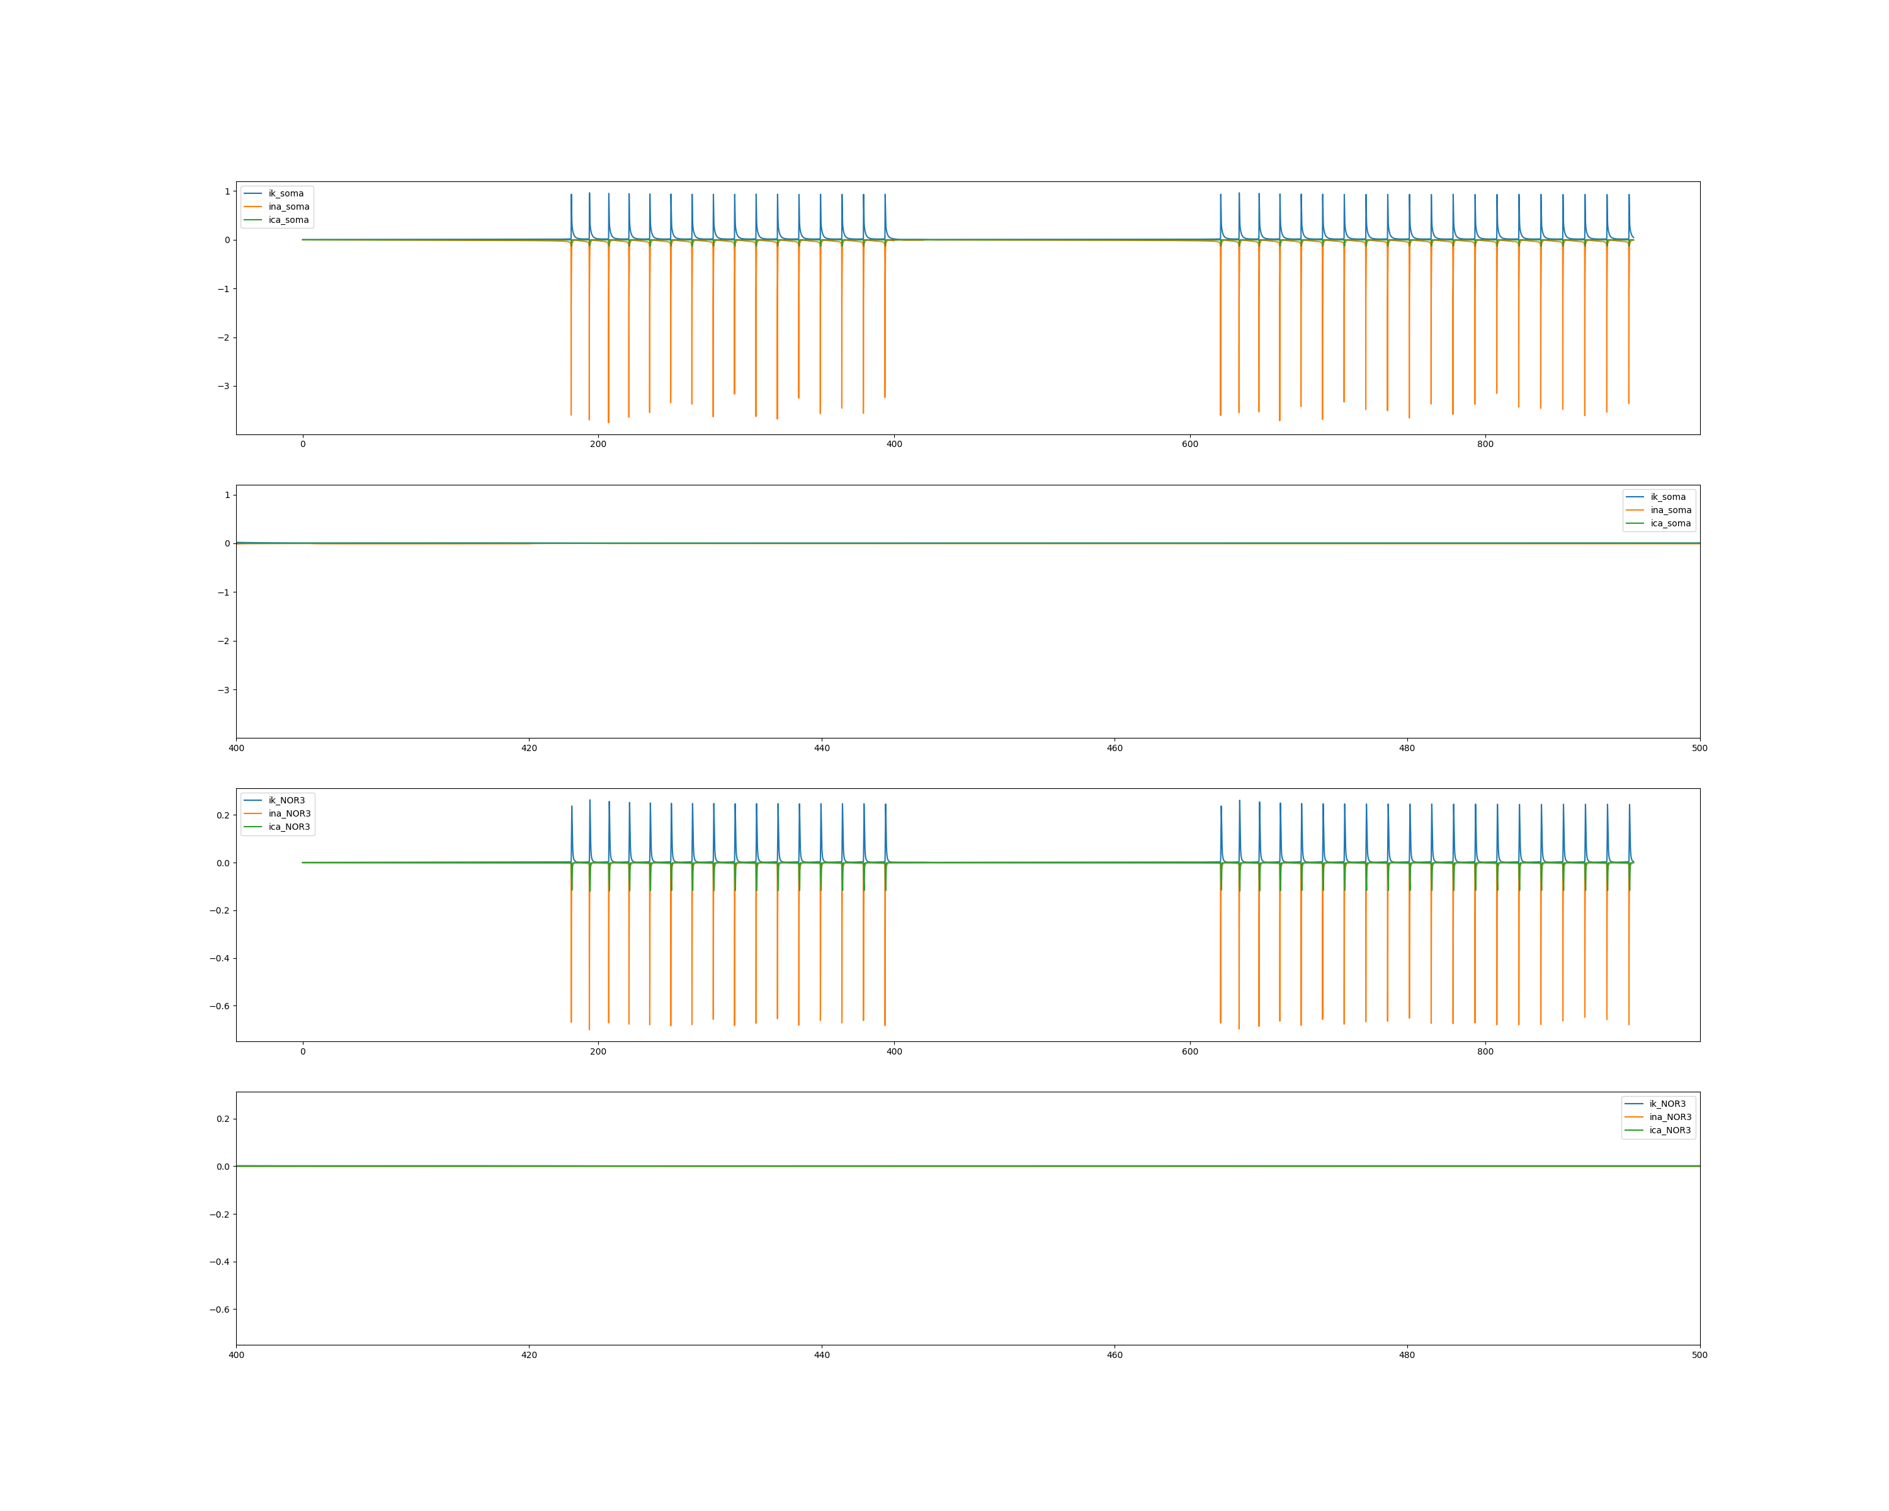
Result – paired pulse depression
Left: Normal; Right: BK KO

Slide 27
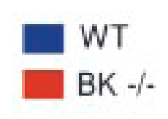
Discussion
Contradict to experimental result
BK counterbalance calcium entry through Cav2.1, leading to stronger depolarization
Possible reasons:
Depolarization block
Unusual Regulation of Calcium Channels
Altered Intracellular Calcium Homeostasis
Compensatory Mechanisms
Left: Normal; Right: BK KO
Notes:
去极化阻滞（Depolarization Block）：BK通道的缺失导致Purkinje细胞在静息状态下去极化，使得钠通道失活，从而阻碍了动作电位的产生。这种去极化阻滞现象解释了为什么Purkinje细胞的放电活动减少。
钙通道的反常调节：虽然理论上BK通道缺失可能会使钙通道更活跃，但实际的细胞生理反应可能更为复杂。钙通道的活性可能受到其他因素的调节，如钙依赖性抑制或细胞内其他信号通路的变化。
细胞内钙离子稳态的改变：BK通道的缺失可能影响了细胞内钙离子的稳态，导致钙离子浓度的变化，进而影响了钙通道的功能。
突触前抑制的增强：BK通道的缺失可能增强了Purkinje细胞的突触前抑制，减少了神经递质的释放，从而减少了突触后神经元的兴奋性。
代偿机制：在BK通道缺失的情况下，细胞可能通过其他离子通道或信号通路的代偿性变化来维持一定的生理功能。
实验条件和模型的局限性：使用的实验模型和条件可能无法完全模拟所有生理状态下的BK通道功能，因此实验结果可能受到特定条件的限制。

Slide 28
Discussion
How to switch between different firing patterns? (tonic and bursting)
Statistical result from biological context.

